Slide 1




Pre-Season Fitness and Conditioning
Tips for the best season of your career

Slide 2
How does exercise impact us as officials?
In a typical game, each official runs 2-3 miles
Tournaments are even worse – can mean running over 20 miles in a weekend
We need to be in position to get the call correct
If you are physically tired or sore, this takes away your ability to focus on the job
If you are injured, you can’t work at all
The more in shape you are, the more focused you will be, thus increasing player safety

Slide 3
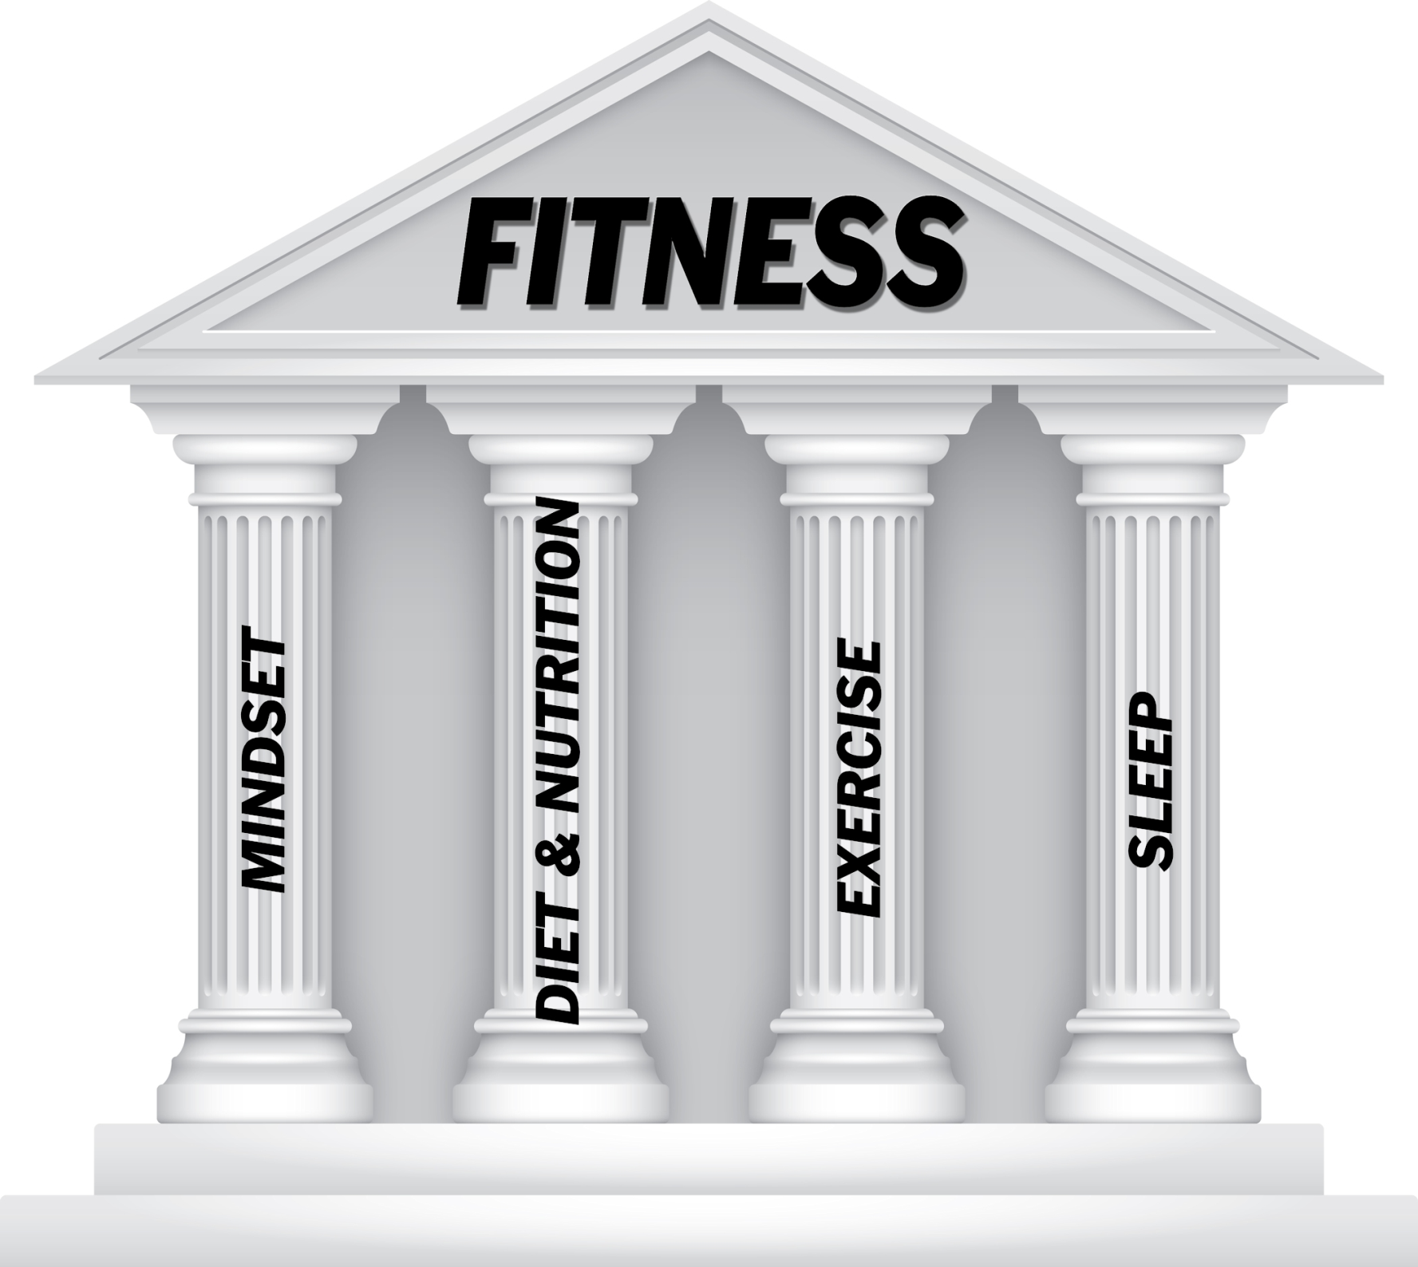

Slide 4

MINDSET
Enter each game with an open mind and clear focus
You are there to make sure the game is played by the rules and prevent injuries
Be prepared physically and mentally
Control the Controllables
  Effort
  Attitude
  Preparation
  Present Moment
Have proper attire and footwear for conditions and the weather

Slide 5
DIET and NUTRITION
General guidelines:
A healthy eating pattern includes: A variety of vegetables: dark green, red and orange, legumes (beans and peas), starchy and other vegetables
Fruits, especially whole fruit
Grains, at least half of which are whole grain
Fat-free or low-fat dairy, including milk, yogurt, cheese, and/or fortified soy beverages
A variety of protein foods, including seafood, lean meats and poultry, eggs, legumes (beans and peas), soy products, and nuts and seeds
Oils, including those from plants: canola, corn, olive, peanut, safflower, soybean, and sunflower. Oils also are naturally present in nuts, seeds, seafood, olives, and avocados.

Slide 6
Limit the following:
Food/Drinks containing added sugars
Foods with saturated and trans fats
Foods containing high amounts of sodium
Alcohol consumption
The information provided comes from
  http://health.gov/news/dietary-guidelines-digital-press-kit/2016/01/top-10-things-you-need-to-know/

Slide 7
EXERCISE
You have to be ready to run with teenagers
If you haven’t been active, take small steps to gradually increase your activity
  Get up and move every hour during the day
  Make exercise a priority – invest in yourself
  Start by walking and gradually increasing activity
    i.e. Walk for 2 minutes, Jog for 2 minutes
Increase intensity to 30+ minutes/day
MONITOR your activity (FitBit, Pedometer, Garmin, etc.)
  Are you doing as much as you think you are?

Slide 8
Increase your Flexibility
Do stretches DAILY throughout the year
  Hamstrings, Quadriceps, Calf muscles, Groin, Gluts
Make sure your muscles are warm (very light jog)
Do not start a game without preparing your body with a warm up and stretching
Flexibility will significantly decrease your chance of being injured and recovery time after games
The season is much longer if you are fighting injury
Video Link to Dynamic Warm-up: Click HERE

Slide 9
SLEEP
According to the National Sleep Foundation, adults should get 7-9 hours of sleep each night.
Needs will vary by individuals:
  Do you feel rested?
  Do you rely on stimulants (coffee, caffeine, etc.)?
  Do you have trouble falling asleep?
  Health issues?
  Is it difficult to focus?
Try increasing your daily amount of sleep
Can be monitored by some exercise trackers

Slide 10
BE THE BEST YOU CAN BE and
HAVE A GREAT SEASON!!!
Check out www.keystonerefs.org for more useful information to prepare for the season

