Slide 1

Personal Fouls
3/30/16

Slide 2
Get it Correct
Color
Number
Offense
Time
Explanation

Slide 3
Topics covered Rule 5
Personal Fouls
Cross Check (Sec 2)
Illegal Body Check (Sec 3)
Checks involving Head/Neck (Sec 4)
Slashing (Sec 7)
Tripping (Sec 8)
Unnecessary Roughness ( Sec 9)
Unsportsmanlike Conduct ( Sec. 10)

Slide 4
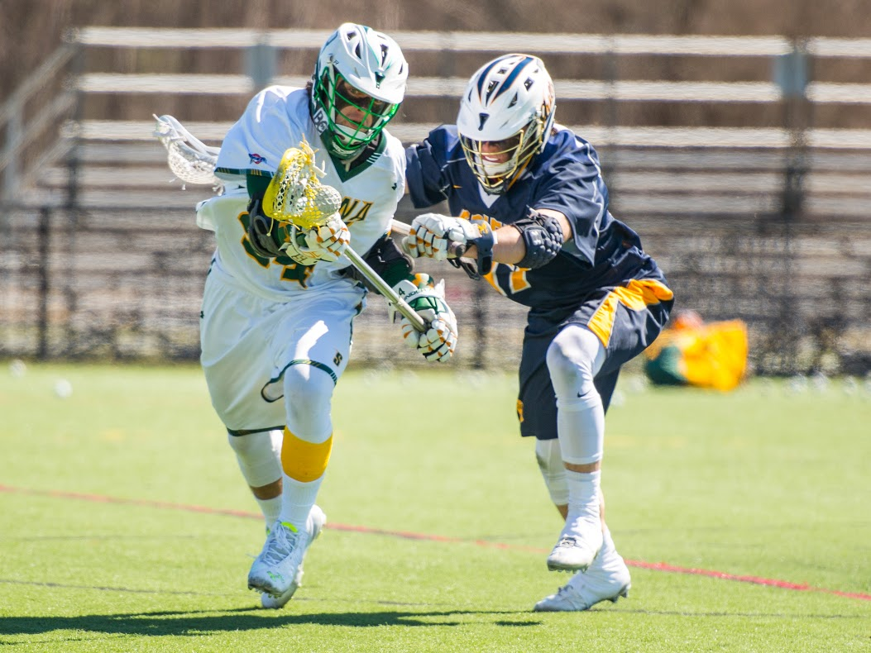
Cross check
Check with part of the shaft between the player’s hands
- Either by thrusting
- Holding extended from the player’s body

Slide 5
Illegal Body Checks - Two varieties
IBC
IBC 2-3 minute Non Releasable
Body checking a player without possession or within 5 yds of the ball
Body check form the rear or below the waist
Body check when opponent is on the ground and not on his feet
Body Check that targets a player in a defenseless position
ie: from the blindside,
possible recipient of a
“buddy pass”

Slide 6
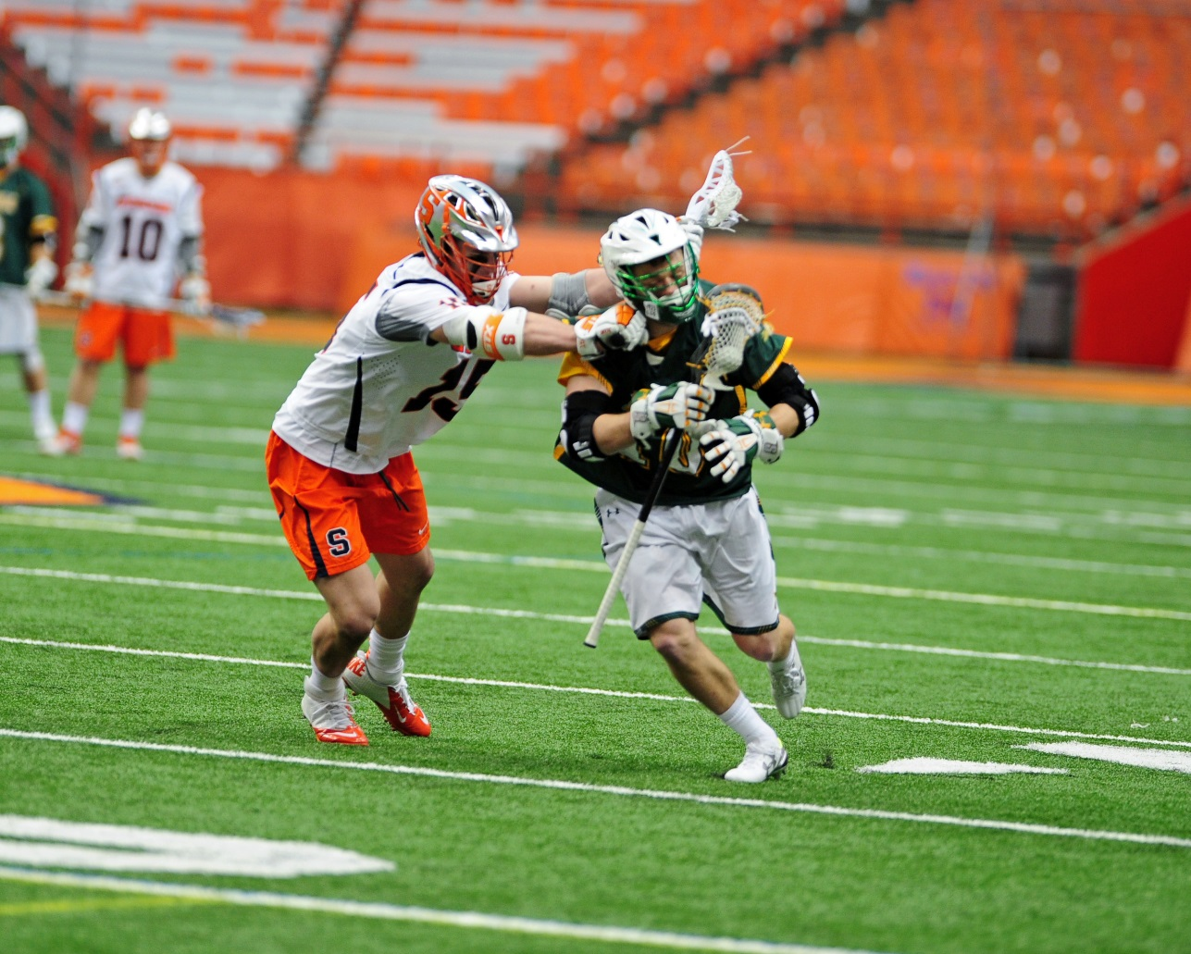
Checks involving head/neck
Contact should not be initiated to opponents head or neck
Infractions are enforced with a 2 or 3 minute non releasable foul.
If egregious enough, ejection is an option.

Slide 7
Slashing
Swinging a crosse at an opponent’s crosse or body with deliberate viciousness or reckless abandon, regardless if contact is made.
  Point in addition to the obvious slash, see the attackman who swings uncontrolled at the clearing midfielder.
  Counter point See 5.7.1 Situation Contact by itself does not constitue a foul, if not a definite blow or stike, it is considered a brush.

Slide 8
Tripping
Tripping is obstructing an opponent at or below the waist with the crosse, hands, arms, feet or legs, by any positive primary action.
If a player legally checks his opponent and the result is to cause the opponent to trip over his own stick, no foul is committed.
Similarly, if an opponent falls over the players crosse while the player is attempting pick up the ground ball, no foul is committed.

Slide 9
Unnecessary Roughness
Excessively violent hold or push
“blowing up the screen”
Avoidable deliberate act, may include a legal body check
Checks delivered with gloved hand may not be a punching blow

Slide 10
Unsportsmanlike Conduct
Argue with Official
Profane or obscene language or gestures
Bait or call undue attention to oneself (ex: post goal celebration)
Deliberately using hands or fingers during face off
- note inadvertent touching is not unsportsmanlike

Slide 11
Last Slide - I Promise
Fouling Out
VS Ejection
5 minutes of personal fouls
IS Permitted to play next game
2 Non releasable unsportsmanlike fouls
Egregious hit, official can eject. Ie checks to head/neck
Must notify assigner of team, number and name of player as this player may NOT play in next contest

