Slide 1
Managing the Game: Parents, Players and Coaches
Michael Nastasi Sr., KLOA

Slide 2
Official Crisis?
Newsday: https://www.newsday.com/sports/high-school/high-school-umpires-referees-officials-1.31620328
Post: https://nypost.com/2018/09/29/deranged-adults-scaring-off-refs-and-ruining-youth-sports/https://www.uslacrosse.org/blog/where-are-the-officials-going
US Lacrosse: https://www.uslacrosse.org/blog/where-are-the-officials-going

Slide 3
Things to keep in mind
Parents are increasingly spending more and more money on youth sports:https://time.com/4913284/kids-sports-cost/
Year round sports
Kids under pressure
Coaches under pressure

Slide 4
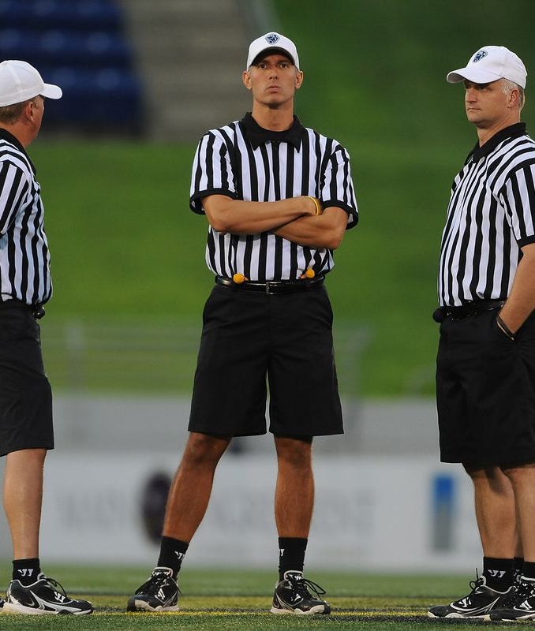
Parents behaving badly
WARD!!!!!!!!
In the HELMET!!!!
Thats locked in REF!!!!!!
You’re atrocious ref
Worst officiated game I’ve ever seen
Vigilante mom: https://www.youtube.com/watch?v=dLGDYCwMB-Y

Slide 5
Parent and Fan management
#1 Rule, you are not there to take abuse
Zero tolerance
Use your resources (gameday staff, tournament staff, etc)
Keep it light, engage fans in a friendly way, if they get stupid they go home
Communicate with coaches if parent/fan is being abusive and disrupting the game

Slide 6
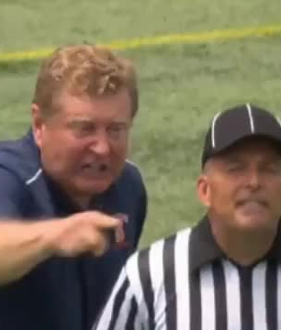
  Coaches behaving badly
Constant abuse
Questioning every call
Yelling constantly
On the field constantly
Blaming officials for teams lack of performance or result

Slide 7
  Coach management
Communication
Escalation of force
Understanding situations
Understanding Personalities
Assertiveness
Humility, admit if you’re wrong and move on

Slide 8
Players behaving badly
Fights
https://www.youtube.com/watch?v=j6Hoi10eYkg
Arguing, disrespect
Taunting, celebrations

Slide 9
Player Management
Communication
Preventative officiating
Respect
Build rapport

Slide 10
Game management thoughts
Look like one!!!!
Work hard!!!!!
Know the rules!!!!!
Teamwork
Respect the players, fans, and coaches

