Slide 1
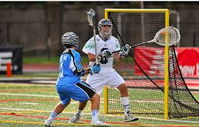
OFFICIATING THE CREASE
THE MOST IMPORTANT AREA ON THE FIELD
WHERE YOU NEED TO BE RIGHT
ALL OF THE TIME, EVERY TIME
Crease Violations are Technical Fouls and are enforced as technical fouls.
Play-On technique (rather than under the general rules for technical fouls) or Flag-Down Slow Whistle depending on clearing team possession or not.

Slide 2
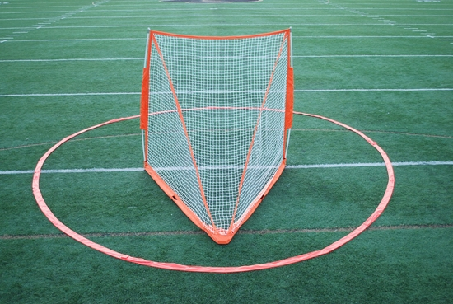
Crease Dimensions
Around each goal shall be a plainly marked circle known as the goal crease. The area within the crease line shall not be painted. This circle shall be marked by using the midpoint of the goal line as the center and drawing a circle with a radius of 9 feet around that point to the outside edge of the line.
The goal-crease area is the circular surface about each goal within and including the goal-crease line itself.

Slide 3
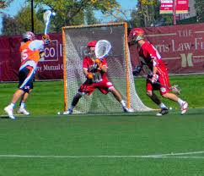
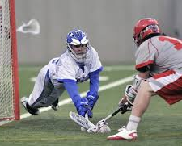
2 Main Rules of Crease Play
Goal-Crease Privileges 4-18
Only Goalkeeper gets protection inside crease area. No opposing player can make contact with goalie or his crosse while goalie is in crease.
No other defender can be in crease with intent on blocking shot.
Goal-Crease Prohibitions 4-19
An Attacking player may Not be in an opponents goal-crease area at any time.
Attacking player can’t leave his feet on own volition and land in crease area.
A defending player, including goalie, in possession of ball, may not enter the goal-crease area, nor may he remain in within the goal-crease area in possession of the ball longer than four seconds.

Slide 4
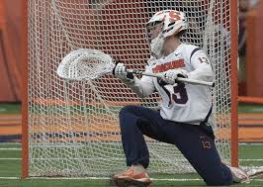
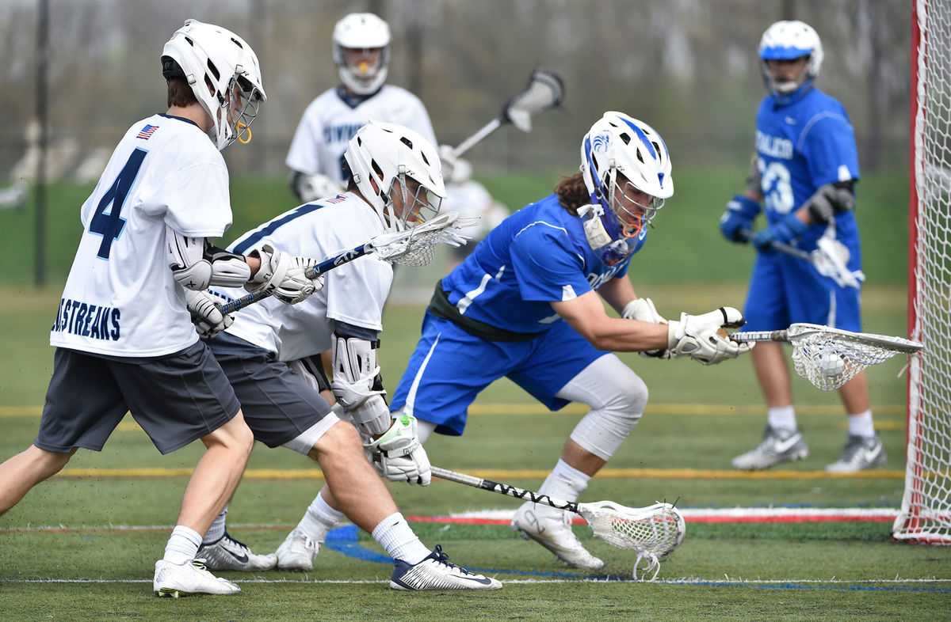
2 Situations of Crease Play to officiate.
Team attacking goal > goalie’s team playing defense: Crease Violations, Technical fouls, Picks > Goal or No Goal.
Goalie or his teammate gains possession of ball now on offense > clearing ball. Goalie Interference, crease violations > Play-On’s or could be FDSW.

Slide 5
Goal-Crease Privileges NFHS Section 4.18
The goalkeeper, in his own crease area, may stop or block the ball in any manner with his crosse or body. The goalkeeper may block the ball or bat it away with his hand, but he may not catch the ball with his hand. However, if the ball is outside the crease, the goalkeeper may not touch it with his hand even if he is within his crease. (See Rule 6-6-a.) The goalkeeper or any other player of the defending team may receive a pass while in the crease area.

Slide 6
Goal-Crease Privileges 4-18
No opposing player may make contact with the goalkeeper or his crosse while the goalkeeper is within the goal-crease area, regardless of whether the goalkeeper has the ball in his possession. An attacking player may reach within the crease area to play a loose ball as long as he does not make contact with the goalkeeper or the goalkeeper’s crosse.
When the goalkeeper is in his own crease area, any portion of the goalkeeper’s crosse extended outside the cylinder of the crease area, but not the goalkeeper’s body, is subject to being checked under the same circumstances as the crosse of any other player, except when the ball is in his crosse.

Slide 7
Goal-Crease Privileges 4-18
No defensive player, other than a properly equipped goalkeeper, can enter his own crease with the PERCEIVED INTENT on blocking a shot or ACTING as a GOALKEEPER.
Penalty: Conduct foul on the defensive player. A second violation by the same team will be enforced as releaseable unsportsmanship conduct served by the offending player (the second or subsequent player)
The officials will stop play as soon as they notice this situation. However, if a shot is already in flight (released) when noticed, the shot will be allowed to come to its normal conclusion before blowing the whistle to stop play.

Slide 8
Crease Rules: Prohibitions 4-19
An attacking player may not be in the opponent’s goal-crease area at anytime.
A defending player, including the goalkeeper, with the ball in his possession, may not enter the goal-crease area, nor may he remain within the goal-crease area in possession of the ball longer than four seconds.
A player is considered to have entered the goal-crease area when any part of his body touches the goal-crease area.
A player is considered to be outside the goal-crease area when no part of his body touches the goal-crease area or when he is airborne and his last ground contact was outside the goal-crease area.

Slide 9
Crease Rules: Prohibitions
An attacking player may not be in the opponent’s goal-crease area at anytime.
When an attacking player is in the crease, you need to decide how the player got in the crease:
Did he stroll in on his own, dive or jump?
Did he get pushed in Legally? or Illegally? Interfered with?
Was he IBC’d in? Roughed-Up?
Get help from your partner! Especially if you’re the lead and shot misses goal > you are running to the end line or play behind goal.
Shooters attacking goal and missing shot sometimes run in or fall into crease
Farside or Trail need to stay with shooters

Slide 10
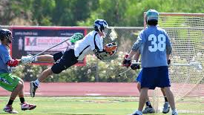
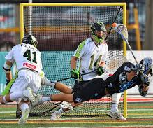
Goal Not Counted
After a player in the act of shooting or his teammate makes contact with the goalkeeper in the crease or touches any part of the goal or netting before the ball enters the goal.
If an attacking player, in possession of the ball and outside the crease area, dives or jumps (becomes airborne of his own volition), prior to, during, or after the release of the shot and lands in the crease, the goal shall be disallowed.

Slide 11
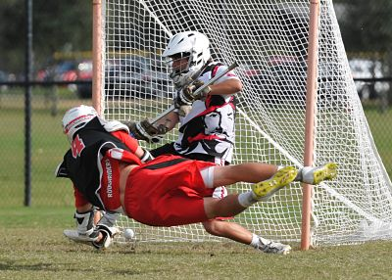
AIRBOURNE PLAYER
An airborne player. A player in midair, when playing a ball, is considered to be where he last was in contact with the field.
The goalkeeper is out of the crease without the ball and his teammate throws him a high pass. The goalkeeper jumps in the air to catch the ball and lands in the crease. This is an illegal re-entry violation. The ball shall be awarded to the other team.

Slide 12
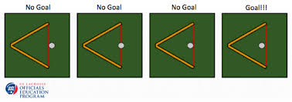
Loose ball breaks goal line
A goalkeeper, who is in possession of the ball in the crease, brings his crosse back through the plane of his goal and the ball becomes loose across the goal line. RULING: A goal is awarded to the opposing team.
If the goal cage is accidentally dislodged during play, officials shall let a scoring play continue and allow the goal if the ball enters the goal cage. Officials should stop play if/when no scoring play exists and replace the goal cage.
Goal Counted or Not

Slide 13
Mommy Goals We have all seen these It Happens or Will Happen
A2 shoots on goal. The ball gets stuck on the outside of the net or is loose in the crease when the official blows the whistle, thinking that a goal was scored. RULING: Stop play and award the ball to defensive Team B.

Slide 14
BALL OUT OF PLAY IN GOAL-CREASE AREA: 4-20
If the ball becomes mired in the mud within the goal-crease area or ensnared in the netting, time shall be suspended by the officials, and the ball shall be awarded to a defensive player.
If the goalkeeper loses his stick with the ball in it within the goal crease, the whistle shall be blown and the ball awarded to the defensive team.

Slide 15
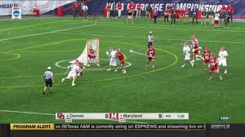
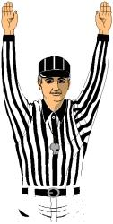
3-MAN Crease Coverage Settled Situation
Farside, Rabbit
If ball carrier is going away from you, take body back of player and opposite official look at feet of attacking player in crease or not before shot taken.
Definitely easier in 3-man game.
If defender is trailing attacking player,
Need to see and decide:
Was it a push? or did he leave on his own, jumping, diving?
Good players feel push on back and jump!
Don’t be fooled!
Good Tight Crease coverage
Trail
Lead

Slide 16
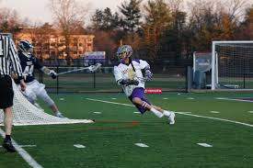
New 2-MAN Crease Coverage Settled Situation
Lead
If ball carrier is going away from you, take body back of player and opposite official look at feet of attacking player in crease or not before shot taken.
Harder to do in 2-man game.
Trail

Slide 17
New 2-MAN Crease Coverage Settled Situation
Trail
Lead

Slide 18
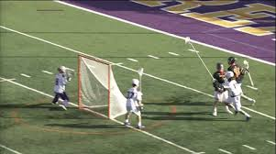
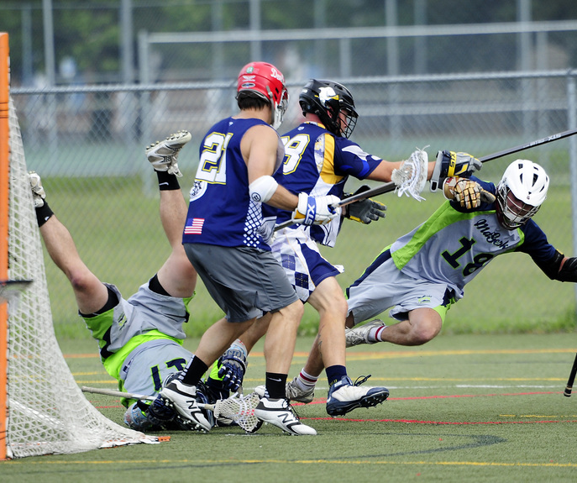
Picks: Behind , Around the Crease Crease Area might be the most Critical area on the field
Watch picks for attacking players’ feet in / on crease line
Moving or Stationary Pick
UR against Defender that causes crease violation

Slide 19
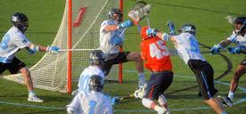
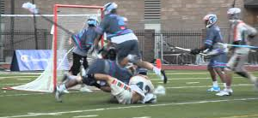
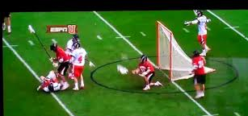
Body Checking Crease Area can be Roughest area on Field
A1 takes a shot from midfield. While the ball is within 5 yards of A2, B1 legally checks A2, causing A2 to be in the air above the crease area. The ball enters the goal, then A2 lands in the crease. RULING: Legal goal, unless A2 lands in the crease before the ball enters the goal, then no goal.
Often late hits, unnecessarily rough hits, crosse checks
Trail and Farside officials need to stay with shooters as Lead has goal area.
Watch for Goalie checks:
both on Goalies > teammates will come to his aide or retaliation
and by Goalies who like to light up attackmen

Slide 20
Crease Violations/Goalkeeper Interference 6-2
When the defensive team has possession of the ball, infringements of the rules involving the crease shall be penalized as follows (rather than under the general rules for technical fouls):
Any crease violation or interference with the goalkeeper of a technical nature while the ball is in possession of the defensive team outside of the crease shall result in a FDSW situation.
Any crease violation or interference with the goalkeeper while he and the ball are in the crease, whether or not he has possession of the ball, shall be a Play-On. If the goalie has possession and fails to run the ball out of the crease or Successfully completes an outlet pass, the ball is awarded to the goalie’s team at midfield across the midfield line in the goalies’ offensive side. If the ball is loose in the crease and the goalie gains possession, the Play-On is over.

Slide 21
Crease Situations and Rulings Crease Privileges
A loose ball is on the ground in the crease or is in the air above the crease. Team B’s goalkeeper, who also is in the crease, uses his hand to bat the ball into his crosse or out of the crease. RULING: Legal play.
1
A loose ball is in the crease. The Team B goalkeeper picks up the ball with his hand and puts the ball in his crosse. RULING: Technical foul. The ball is awarded to Team A outside the attack area.
2
Goalkeeper B1, after making a save, passes the ball to B2. B2 passes back to B1 in the crease. RULING: Legal play.
3
Goalkeeper B1, with possession of the ball, extends his crosse outside the crease and still has one or both feet in the crease when A1 checks his crosse. RULING: Interference, play-on. Play continues or award the ball to Team B at the center of the field. See Rules 7-10 and 7-11.
4
A loose ball is in the crease. Goalkeeper B1 has his crosse over the ball and is about to rake the ball. A1 checks through B1’s crosse from the front, claiming he was playing a loose ball. RULING: Interference by A1, play-on. Play continues or the ball is awarded to a Team B player at the spot of the violation.
5

Slide 22
Crease Situations and Rulings Crease Privileges
A loose ball is in the crease. Goalkeeper B1 has his crosse over the ball and is about to rake the ball. From the side of the crease, A1 pokes his crosse at the ball; and, as B1 draws the goalkeeper’s crosse back, contact is made with A1’s crosse. RULING: Interference by A1, play-on. Play continues or the ball is awarded to a Team B player at the spot.
A loose ball is in front of the crease. Goalkeeper B1 reaches out to pick up the ball, and A1 checks B1’s crosse. RULING: Legal play. The goalkeeper does not have possession of the ball.
Loose ball in front of the crease. Goalkeeper B1 reaches out and gains possession of the ball. A1 checks B1’s crosse while it is still outside the crease. RULING: Interference, play-on. Play continues or award the ball to Team B at the center of the field.

Slide 23
Crease Plays
Open in Slides

Slide 24
Crease Situations and Rulings
The goalkeeper is in the crease, making a pass to begin his clear. The goalkeeper’s crosse collides with the crosse of A1, who is standing on the edge of the crease with his crosse in a covering position, thus causing the ball to drop to the ground. RULING: Interference by A1, play-on. The goalkeeper, while clearing from the crease, has protection on passes for clear, regardless of whether the attack player moves his crosse. Play continues or award the ball to Team B at the center of the field.
Can the goalkeeper be called for a personal foul if his crosse slashes an opposing player after an outlet pass? RULING: Yes. The privileges and protections of the goalkeeper do not permit him to gain an unfair advantage.

Slide 25
Crease Situations and Rulings
A player may reach into the crease to play a loose ball. However, he does so at the risk of being called for interference if contact is made by his crosse with the goalkeeper or the goalkeeper’s crosse.
The crease rule was not intended to give the goalkeeper an advantage by initiating contact with an offensive player’s crosse to get an interference call. It was intended to give the goalkeeper added protection while in the act of making a save or gaining possession of a loose ball in the crease. In such a case, if there is contact between the offensive crosse and the goalkeeper crosse, then interference has been committed.
A loose ball is in the crease. A1 covers the ball to rake it back. Goalkeeper B1 checks A1’s crosse. RULING: No interference.
A loose ball is in the crease. A1 bats the ball with his crosse, the ball enters the goal and then contact is made with goalkeeper B1’s crosse. RULING: Legal goal—no interference. Contact occurs after play has ended.
A loose ball is in the crease. A1 bats the ball with his crosse, but the ball is still loose in the crease. Contact is then made with goalkeeper B1’s crosse. RULING: Interference, play-on.

Slide 26
Crease Situations and Rulings
A1 is in possession of the ball on the edge of the crease. A1 breaks the plane of the goal with his shot, and then contact is made with goalkeeper B1’s crosse or body, the goal or the net. RULING: Legal goal. Contact occurs after play has ended.
During the course of play if a goalkeeper’s stick becomes broken or any other required equipment becomes broken or dislodged, the officials will stop play as soon as they notice the problem, regardless of whether the goalkeeper is in or out of the crease.
When play is stopped for this reason, the ball is awarded to the team that was in possession when play was stopped or, if the ball was loose, by the alternate-possession rule. (Exception: If the ball is in the crease when play is stopped, possession is awarded to the defensive team.)
If the goalkeeper notices the broken equipment, he should verbally notify the officials immediately during the play.

Slide 27
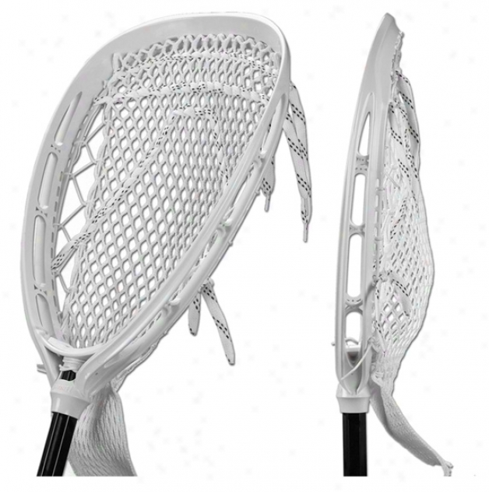
Crease Situations and Rulings
A1 shoots and scores. When the official goes to get the ball out of the goal, the goalkeeper shows him that his crosse or any other piece of required equipment is broken. RULING: The goal stands since the problem was not noticed by the officials nor acknowledged by the goalkeeper before the shot was in flight.
Goalkeeper B1, seeking to stop play in an unsettled situation, (1) Intentionally breaks required equipment or drops a glove; or (2) Yells to the officials that he has broken equipment when he does not to get them to stop play. RULING: The officials stop play and assess a two-minute nonreleasable unsportsmanlike conduct penalty on B1.
While team A is in possession, goalkeeper B1 drops his crosse. RULING: Play does not stop for a dropped goalkeeper crosse, only a broken one, so B1 must retrieve his crosse. If B1 plays on without a crosse, he is guilty of illegal procedure.

Slide 28
Jumping or Diving (Airbourne) Players
If an attacking player, in possession of the ball and outside the crease area, dives or jumps (becomes airborne of his own volition), prior to, during, or after the release of the shot and lands in the crease, the goal shall be disallowed.
An attacking player may legally score a goal and touch the crease area, provided the ball enters the goal before to the contact with the crease and his feet are grounded prior to, during and after a shot.

Slide 29
Crease Situations and Rulings
A1 drives toward the goal and jumps or dives into the crease. (1) The ball goes into the goal; or (2) The ball does not go into the goal. RULING: (1) No goal. The ball is awarded to Team B. (2) Play-on or whistle.
A1 dives or jumps toward the crease and, while in the air, is illegally checked into the crease. (1) The ball goes into the goal; or (2) The ball does not go into the goal. RULING: (1) Flag-down, no goal, assess penalty; (2) Flag-down, assess penalty.
A1 dives or jumps into the air space over the crease and, while in the air, is legally pushed or checked, landing in the crease. (1) The ball goes into the goal; or (2) the ball does not go into the goal. RULING: (1) No goal. The ball is awarded to the defensive team. (2) Play-on for the defense or whistle.
A1 jumps and is over the crease. The goalkeeper is in the crease and contacts A1 while he is in the air. RULING: No goal. Award the ball to Team B.

Slide 30
Crease Situations and Rulings
A1, with his feet grounded prior to, during and after the shot, shoots and the ball enters the goal. During the play, he (1) Is legally pushed into the crease with the ball entering the goal before A1 lands in the crease; or (2) Is illegally pushed into the crease. RULING: (1) The goal counts. (2) Flag-down. The goal counts if the ball enters the goal before A1 lands in the crease.
A1 dodges B1 and continues towards the goal crease. He shoots and scores. After the ball enters the goal, A1 runs through the crease area. RULING: The goal counts. A1 did not deliberately launch himself or become airborne during the play. Running through the area of the crease is considered to be different than becoming airborne and landing in the crease. If shot misses goal, A1 can’t run through the crease.

Slide 31
Crease Situations and Rulings
The ball is inside the crease, and attackman A1 makes contact with the goal or netting, but not the goalkeeper or his crosse. RULING: Legal play, provided the contact with the goal does not occur before the ball entered the goal as part of a shot.
A1, an offensive player, is playing a loose ball in the crease. Neither of his feet is inside or touching the crease line, i.e., he is completely outside of the crease line. He subsequently falls over the crease line with both hands wrapped around his crosse, which comes to rest inside the crease. RULING: A1 is in the crease.
Defensive player B1 makes a save. The ball drops out of his crosse and lands in the crease, whereupon B1 picks up the ball again. RULING: A new four-second count is started.
B1, in the crease, makes a save. After three seconds, he deliberately flips the ball into the air and catches it again (while still in the crease), or (after leaving the crease) rolls or tosses the ball back into the crease deliberately, hoping to get an additional four-second count. RULING: Loss of the ball to Team A.

Slide 32
Crease Situations and Rulings
The defensive team has possession outside of the crease area. The offensive team steps into the crease or interferes with the goalkeeper, who is in his crease. RULING: Flag-down, technical foul.
The goalkeeper leaves the crease with possession of the ball and loses it as the 20-second count winds down. He inadvertently kicks the ball back in the crease. Does the goalkeeper get a new four-second count? RULING: Yes, but the 20-second count continues.
Goalkeeper B1 makes a save, takes one step out of the crease, raises his rear foot off the ground in the crease and then places his rear foot down to the ground in the crease. RULING: The ball is awarded to Team A outside the attack area. The goalkeeper is considered to have left and re-entered the crease while the ball was in his possession.

Slide 33
Crease Situations and Rulings
Goalkeeper B1 makes a save. When out of the crease, A1 legally checks B1 back into the crease, while he is still in possession of the ball. RULING: The ball is awarded to Team A outside the attack area.
The ball is loose in the air or on the ground in front of the goal. A1 bats at the ball while goalkeeper B1 is making an attempt to gain possession of ball, and the two crosses collide. Is this goalkeeper interference if the stick contact occurs (1) within the crease; (2) outside the crease?
RULING: (1) Goalkeeper interference by A1, play-on. Play continues or the ball is awarded to Team B at the spot of the violation. (2) No interference.

Slide 34
Crease Situations and Rulings
B1 not the goaltender picks up a loose ball or catches a pass in th crease. As he is coming out of crease, A1 checks B1’s crosse, causing the ball to enter the goal. Ruling Legal .Goal. Interference may only be called on a designated goalie
Two or more defenders from Team B are standing in the crease in front of the goal with a CLEAR Intention of blocking shots, not defending another player. Ruling: all offending Team B players will serve penalty time. One of the players is assessed a Conduct foul and serve a 30-second penalty. Each of the other players is assessed a one-minute releaseable unsportsmanship like personal foul. If team B had already been assessed a conduct foul under this rule, then all of the offending players are assessed a one-minute releaseable unsportsmanship like personal foul.

