Slide 1
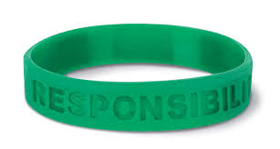
Lacrosse Officials Pre-Game Responsibilities

Slide 2
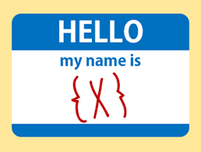
Variables
Who are you working with?
Veteran officials or rookies?
Familiarity with partners?
Familiarity with teams/coaches?

Slide 3
Non-Negotiables
You MUST have a pre-game conference!
You MUST have a pre-game meeting with each head coach!
You MUST read the PIAA sportsmanship message to each coach and captains!
You MUST have coaches certify that their “contestants are legally equipped and uniformed according to NFHA and PIAA adoptions”. Be sure all officials are present!

Slide 4
Contact Your Partners
By noon on the day of contest at the latest.
What time will you arrive?
Where will you meet?
What uniform will you wear?

Slide 5
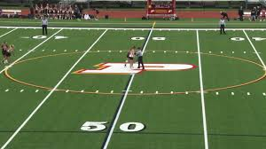
Contact The Home School
Confirm
Game Time
Game Location

Slide 6
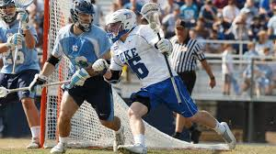
Do Some Research
What are the teams records?
Is it a rivalry game?
On paper….is it a miss-match?
Does the game have importance in terms of standings or qualifying for post-season play.

Slide 7
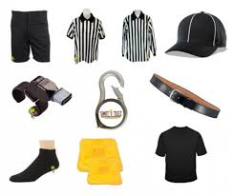
Pack your bag!
Whistles (2)
Scorecards (2)
Pencils (2)
Eraser
Yellow flags (2)
Twenty-second timer (2)
Measuring tape
Watch
Coin
Coach certification cards
Notepad
Rule book

Slide 8
Arrive at Game Site 45-60 Minutes Prior to Contest.
Arrival
Time
Game Time

Slide 9
Pre-Game Meeting * This information may help you manage the game effectively!
Have you or your partners had either team in the past?
Do they ride?
Are they physical?
Do the coaches behave?
Good goaltending?
Do they run a deliberate offense?
Do they violate on face offs?
Are the folks at the table experienced?

Slide 10
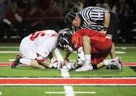
Pre-Game Meeting Continued
Discuss
How are you going to handle face offs?
How are you going to handle stick checks?
When will you speak to coaches?
When will you call captains?

Slide 11
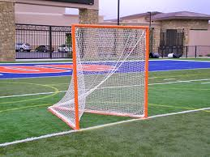
Arrive At The Field
Warm up and Stretch
Inspect the field
Goal creases and lines
Cones
Nets
Penalty area
Speak to table personnel

Slide 12
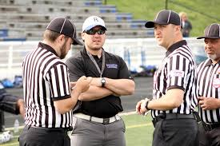
Meet With Coaches
Home coach first
Confirm game time.
Confirm balls on side lines and end lines.
Ask for captains and in-home (first in the book)
Anything special?
Anthem
Announcing starting line-ups
Senior night, etc.
Read PIAA sportsmanship message and be sure to get coaches' certification.
Remind coaches of point of emphasis regarding coaches on the field.
Repeat with visiting coach.

Slide 13
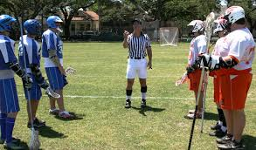
Call Captains
Introductions
Questions
Sportsmanship message
Coin Flip
Make yourselves available for pre-game stick checks

Slide 14
Bring Out the Teams for the Line Up

Slide 15
Have a Great Game!

