Slide 1
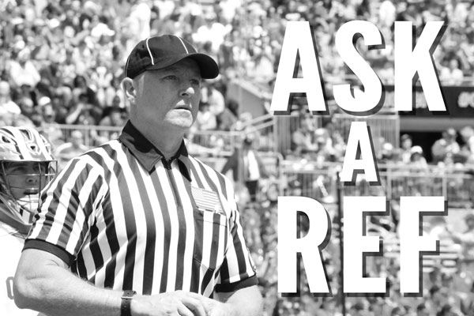
So you want to go to the next Level?
KLOA General Membership Meeting, Monday, May 2, 2016
Jason Costello

Slide 2
mOving from Youth to JV
Know the rules (there is a difference!)
Know how to communicate with both coaches and parents
Make a commitment to get better
Be in shape and make an effort (be in the right position)
Don’t walk

Slide 3
Moving from JV to Varsity
Know the rules
Run, don’t walk.
Make a commitment and develop a relationship with the assigners.
Accept your assignments and commit to your assignments.
Listen to feedback and get better
Communicate effectively

Slide 4
Moving from varsity to upper varsity level games
Biggest difference = know the rules and when to apply the rules
Sometimes, the best call is a “no-call”
The difference between the best officials and everyone else is their ability to make the right call at the right time.
Being in shape and running is IMPERATIVE.
Have to handle the game, not just call the game.

