Slide 1
Field Markings and Their Importance
Know why each of them is there and why they are meaningful

Slide 2
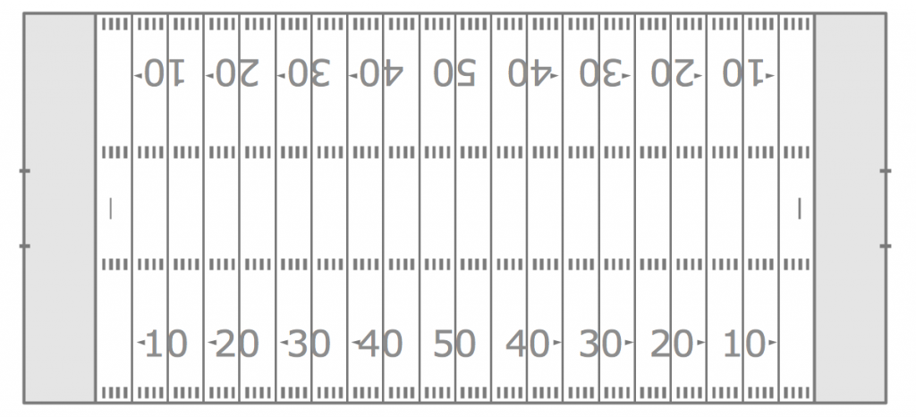
Lacrosse field on a football field

Slide 3
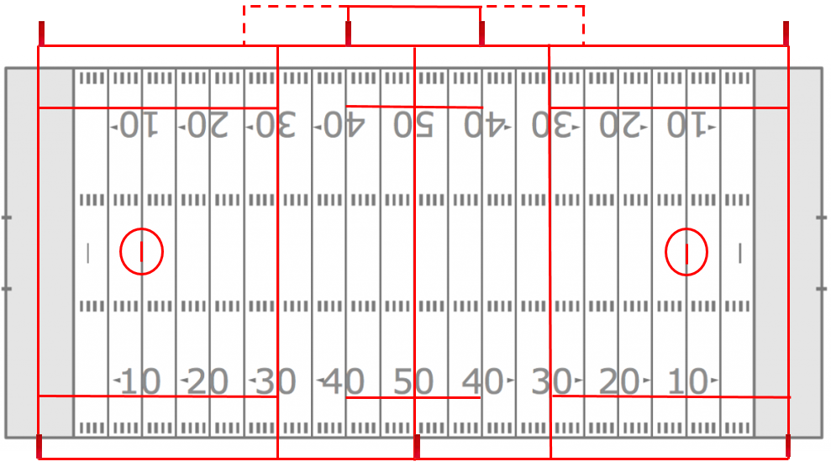
GOAL AREA
GOAL AREA
If markings are difficult to see, use the football lines/markings to help you. Most football markings are permanent - Lacrosse is often painted

Slide 4
WING AREA
Players must be lined up in the wing area for faceoffs
WING AREA

Slide 5
Coaches Area
TABLE/SUB AREA
Coaches Area
Coaches are confined to their area except to exchange crosse or question a rule application.
Subs are allowed in Table/Sub Area only when substitution is imminent

Slide 6
Alley
Alley
Ball being awarded to offense after a penalty or violation in goal area gets restarted in the alley
Alley
Alley

Slide 7
20 seconds to clear this area
Loose ball breaking the plane of midfield or player in possession crossing line satisfies count

Slide 8
GOAL AREA
Once ball is possessed on offensive half of field, 10 seconds to advance ball into GOAL AREA

