Slide 1
Crease and end line play
Jason Costello and Tim Barrar

Slide 2
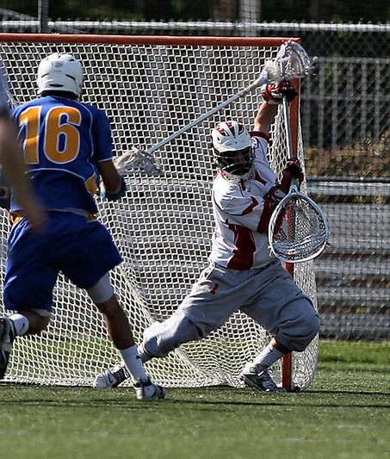
What will be covered…
Goal/Crease violations
Goalie privileges
Officials Position
What to look out for
End line and side line mechanics

Slide 3
Goal/Crease Violations
Rule 6, Section 2: When the defensive team has possession of the ball, infringements of the rules involving the crease shall be penalized as follows:
  Any crease violation or interference with the goaltender of a technical nature while the ball is in possession of the defensive team outside the crease shall result in a slow-whistle, flag down.
  Any crease violation or interference with the goalkeeper while he and the ball are in the crease, whether or not he has possession, shall be a play on. If the goalkeeper has possession and fails to run the ball out of the crease or successfully complete an outlet pass, the ball is awarded to his team in its offensive side of the field at the center X. If the ball is loose in the crease and the goalkeeper gains possession, the play on is over.

Slide 4
Goal privileges
Only the designated goalie has these privileges. Example:
  If a defensive player places the ball in the crease and briefly covers it and an attack man checks the long pole causing the ball to become loose = Legal Play.
  If the goalie covers a loose ball in the crease and a attack man checks the goalie’s crosse = play on technical foul
There is only one designated goalie on the field at any one time.

Slide 5
Rule 4, Section 19
A goalkeeper may stop or block the ball in any manner with the crosse or body. He may bat it away but cannot catch the ball.
No player may make contact with the goalie while he is in the crease. An offensive player may reach in the crease to get a loose ball but cannot make contact with the keeper.
The crosse of the goaltender may be checked if it is outside of the crease cylinder as long as the ball it not in the crease.

Slide 6
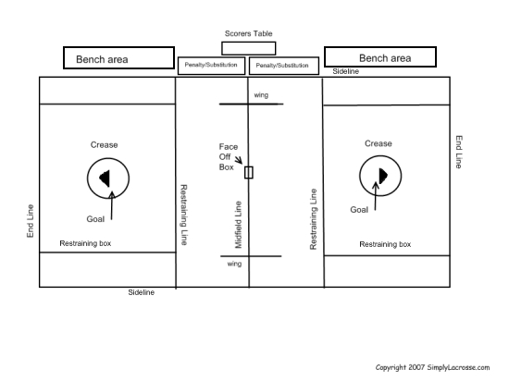
Official’s position

Slide 7
In a two man game…

Slide 8
What to look for…
Goal official must keep his focus on the crease and goal area as well as the end line.
Watch for interference in front of the cage. It can get choppy in front of the goal…
When going to the goal:
  If the offensive player dives and is not pushed, no goal.
  If the offensive player is pushed, flag down.
  If the offensive player steps in the crease and then is pushed, goalie’s ball.

Slide 9
Rule 4, Section 20
If an offensive player deliberately leaves his feet, scores and lands in the crease, the goal is disallowed.
If the offensive player is going towards the goal, shoots and scores after which he steps in the crease – legal goal.
If the offensive player goes towards the goal and the goalie comes out but still has a foot in the crease. The offensive player makes contact with the goalie, shoots, and scores = technical foul, no goal, award the ball to the defense latterly outside the box.

Slide 10

You make the call…a dive?

Slide 11

Very controversial play…

