Slide 1
Boys Lacrosse Rules Points of Interest Summary
Review of the past 5 years NFHS Points of Emphasis
Ed Cavaliere

Slide 2
2016 Rule clarifications Over-and-Back
Over-and-Back Restarts: restarts should always be on the awarded team’s offensive side, since by definition that is where the violation occurred
Since Over-and-Back is a potential Play-On, if the ball travels down the field toward the awarded team’s goal, the restart should start where the ball is when play is killed---always outside of the goal area attack box.
If a shot deflects off of ANY player (offensive or defensive) and the ball goes back over the midfield line while it is still a shot (ball hasn’t come to rest on the field or been possessed by either team) then it’s a free ball. No over-and back violation. New 20 or 10 second count when it gets possessed.
On a 20 second clear, it’s a violation as soon as the timer goes off. Restart it where the ball was when the timer goes off. In awarded team’s offensive half, Start with a 10-second count. Could be a potential Delay-of-Game if chucked way after whistle killing clear.

Slide 3
Emphasize Safety end of games
During end of games, blow-outs including, don’t let teams down by a few hack away at the winning team. They feel they have nothing to lose, so they try to gain some satisfaction by beating up on the winners.
Same goes for managing blow-outs when winning teams subs try to make a name for themselves by beating on loosing team players
We need to officiate the Full 48 or 40 minutes and do what we can to protect players. If it means throwing a dozen flags in the last two minutes, then that’s what it means. Makes it easier for winning team to keep it in!

Slide 4
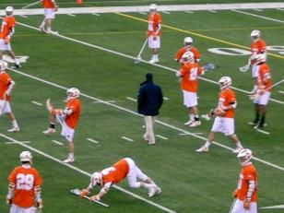
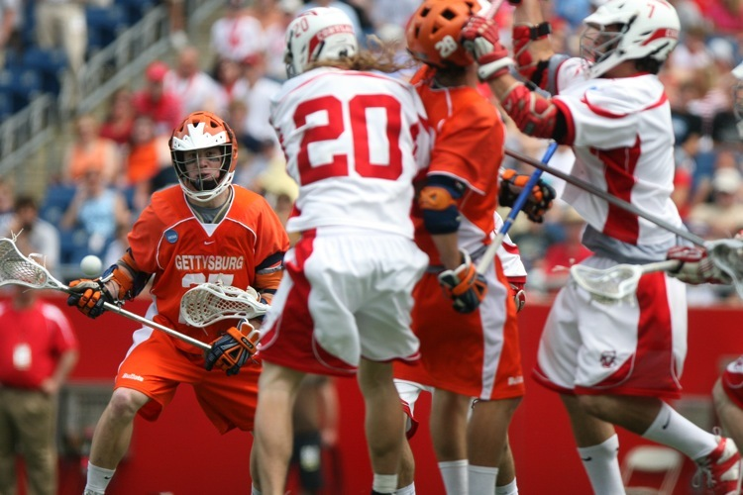
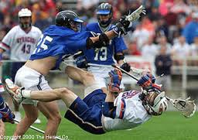
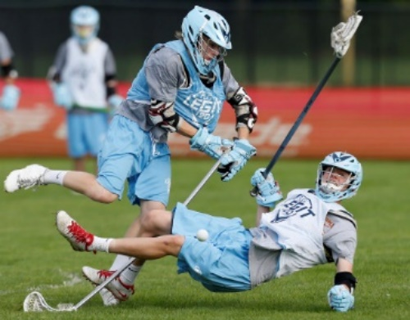
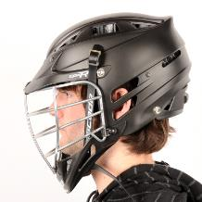
2016 Season POE’s RECAP
3 & 4
HALF TIME WARM-UPS
HELMETS DURING PRE-GAME & PRACTICE TIME
CONTACT : HEAD / NECK /DEFENSELESS PLAYER
DEFENDING THE CREASE-DEFENDING THE GOAL CREASE AREA
HELMET FITTING
NOCSAE APPROVED

Slide 5
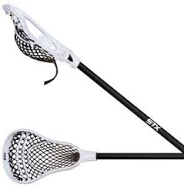
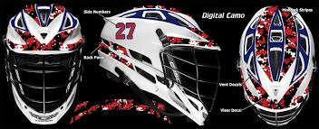
2015 Season POE’s
CONTACT : HEAD / NECK /DEFENSELESS PLAYER
EQUIPMENT INSPECTION
STICKS
HELMET FITTING
NOCSAE APPROVED

Slide 6
CONTACT: HAS BEEN A POE in 3 of PAST 4 YEARS, 2016, 2015, 2013
Contact or Lack of allowed contact in all contact sports
Not only Boy’s Lacrosse or Just sports: CTE issue
In 2014 Contact with Stick , SLASHING was a POE

Slide 7
CONTACT: BREAKING NEWS Ivy League coaches vote to ban tackling during in-season practices
Ivy league coaches voted unanimously to ban tackling during weekly football practices to protect brains of players
Started at Dartmouth in 2010
Practice with tackling pads and dummies only, not helmet contact
Reported in York Times March 1, 2016

Slide 8
CONTACT Bumping in bumper cars banned in the name of Health & Safety
Not allowed to bump each other in bumping cars

Slide 9
CONTACT: DIFFERENT KINDS OF CONTACT
INCIDENTAL
MARGINAL
LEGAL
ILLEGAL
EXCESSIVE
Notes:
Explain contact has to be looked at in following categories

Slide 10
INCIDENTAL
Players
Bumping going for loose ball
Running into someone ‘cause not looking
Usually a No Call
is the Right call

Slide 11
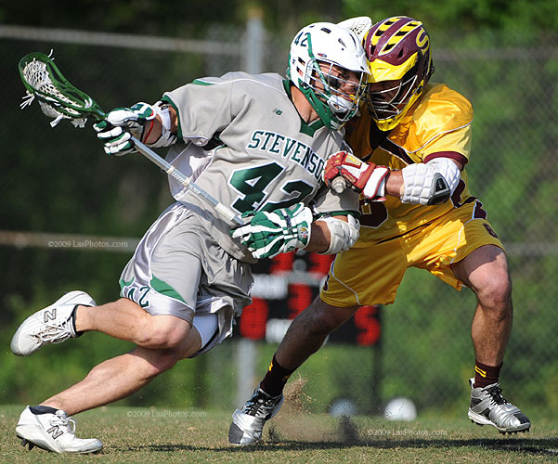
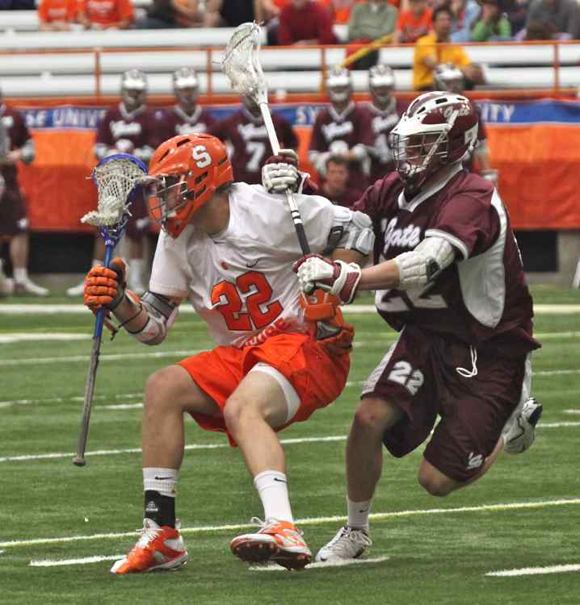
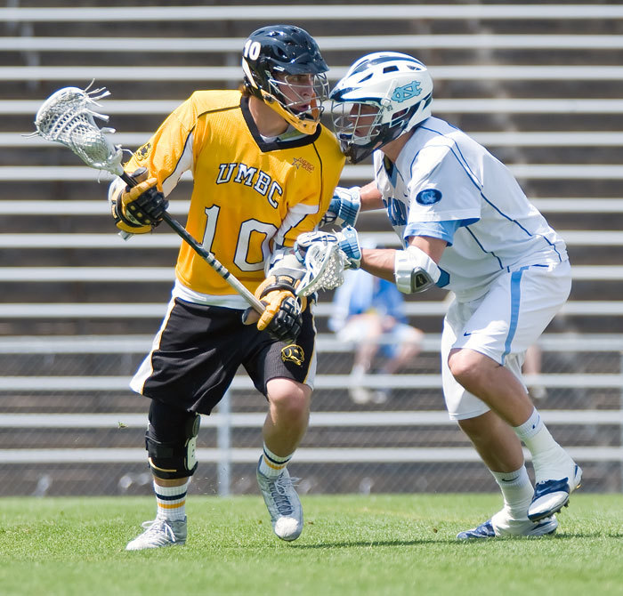
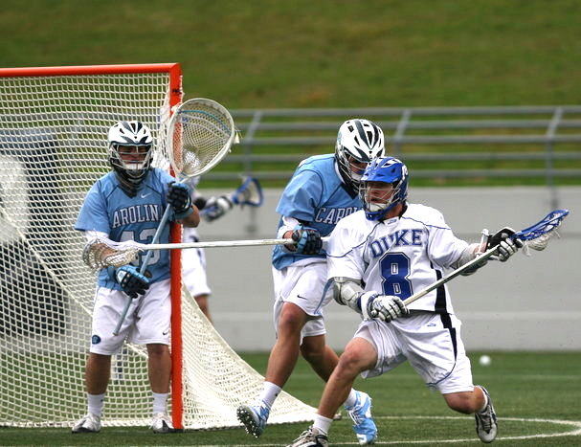
MARGINAL CONTACT WHERE MAKE OUR BONES
Not Violent
Technical in nature
TPOAD must be used
Includes Body & Stick
Requires consistency
Little pushes, tugs where they occur

Slide 12
LEGAL CHECKS Rule 4 Section 15
Good contact > More Violent Collisions
To be Legal: on a player in possession or within 5 yards of a loose ball or ball in flight
Front or side, above waist & below neck
Both hands remain on stick
Not deliberate or excessively violent (UR)

Slide 13
ILLEGAL Rule 5 Sections 3 & 4
Checking a player not in possession or within 5 yards
From Rear or at / below waist
Player with any body part on the ground
If about to be checked player turns back OK if unavoidable
Targets a player in defenseless position, blind, head down, buddy pass
Contact to Head / Neck includes Spearing
BODY & STICK CHECKS
2-3 Minute Locked-in or possible EJECTION Foul

Slide 14
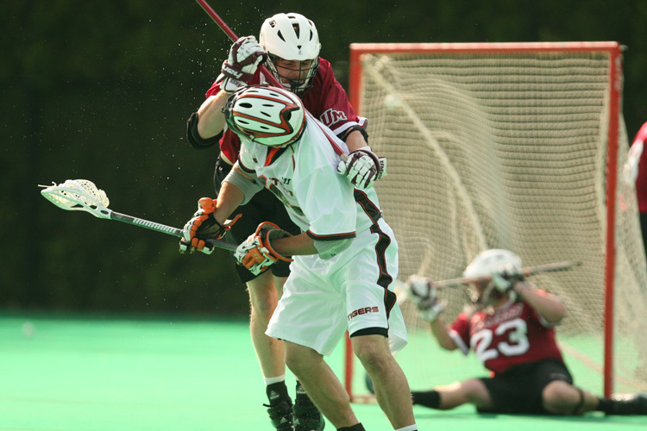
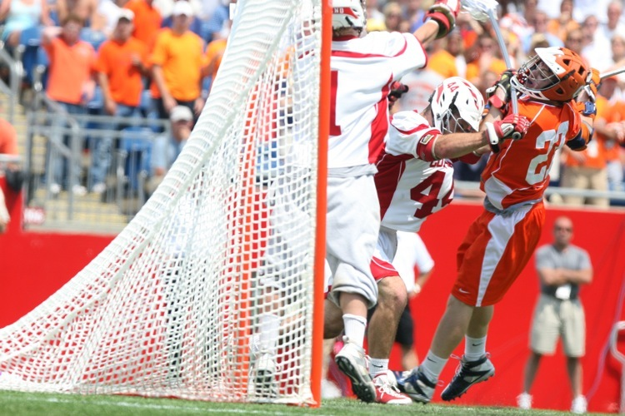
EXCESSIVE
Unnecessarily Rough though could be Legal just not needed
Includes intimidation checks
DEFENSELESS
HEAD DOWN
BUDDY PASS
NOT IN PLAY
MULTI MINUTE
LOCKED-IN
POSSIBLE EJECTIONS

Slide 15
THE OTHER KIND OF CONTACT
CHEAP
DIRTY
INTENT TO INJURE
TAKE OUT BEST PLAYER
UNSPORTSMANSHIP LIKE

Slide 16
PRE-GAME DISCUSSION
RIVALRY GAME
PREVIOUS BAD BLOOD OR DISLIKE
STYLES OF PLAY: ONE TEAM PLAYS MORE PHYSICAL VS, SKILLED
WHERE TO SET THE THERMOSTAT
TEMPERATURE YOU ARE GOING TO ALLOW
ADJUST EITHER WAY AS GAME IS PLAYED
PLAYERS TO LOOK FOR WHO USUALLY PLAYS ON EDGE (LEGAL -ILLEGAL)
LOOKS TO SEE IF YOU WILL MAKE THE CALLS ON ROUGH PLAY
NEED TO HAVE THE INTERNAL INTESTICAL FORTITUDE TO MAKE CALLS ON CONTROLLING ROUGH PLAY

Slide 17
INTERNAL FORTITUDE
IN OTHER WORDS
“INTESTICAL” FORTITUDE
COURAGE
GET TOGETHER TO HELP MAKE
RIGHT PENALTY ENFORCEMENT
PENALIZE ACCORDINGLY
MULTI-MINUTE LOCKED-IN
EJECTION IF WARRANTED

Slide 18
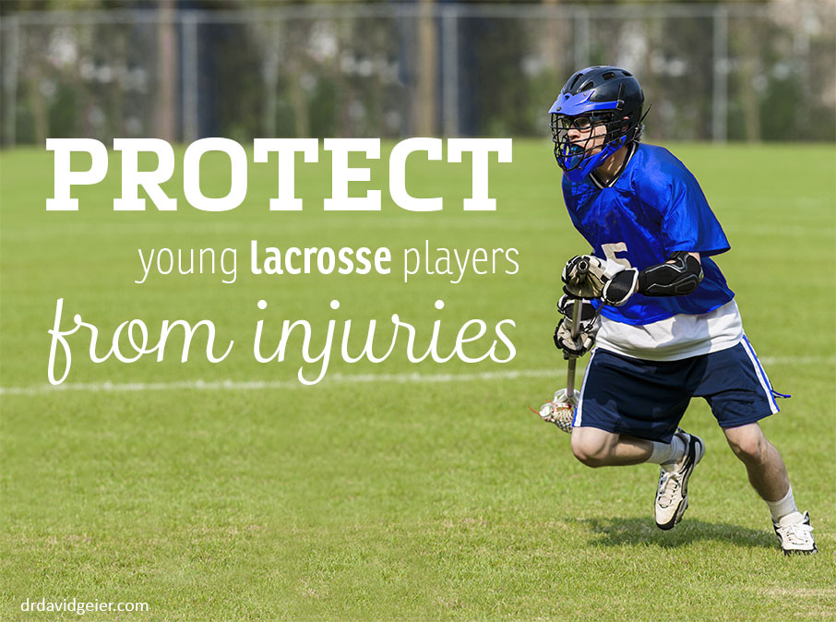
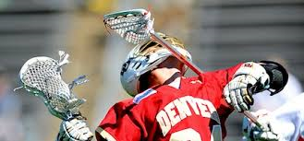
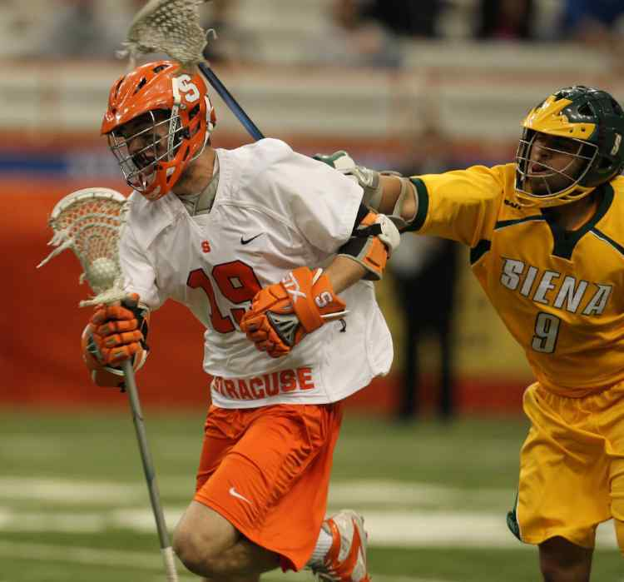
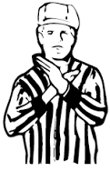
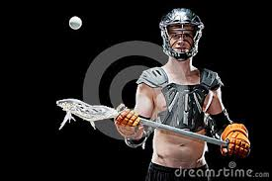
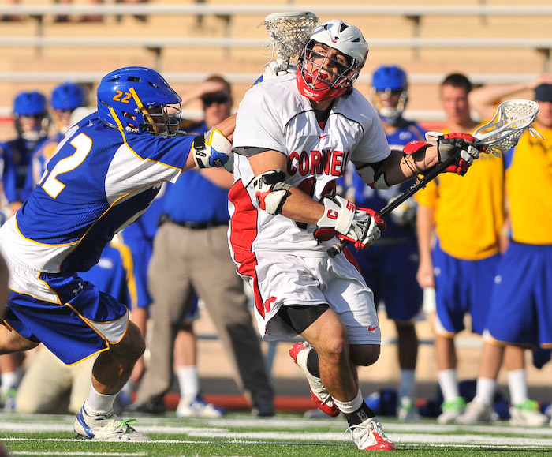
2014 SEASON POI’S
AGE SPECIFIC RULES
AGE APPROPRIATE CONTACT
PROPERLY FITTED EQUIPMENT
NOCSAE APPROVED GAME BALLS
SLASHING

Slide 19
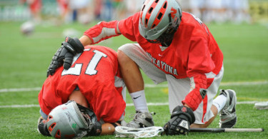
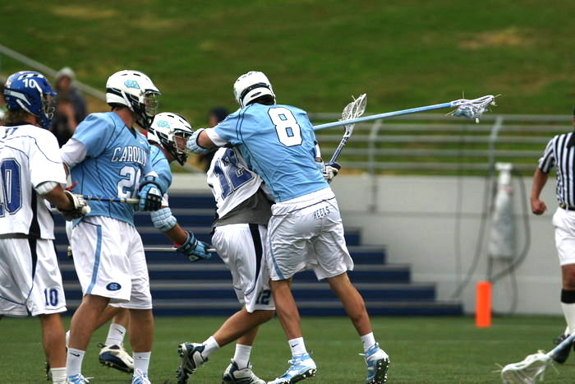
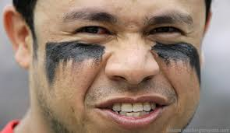
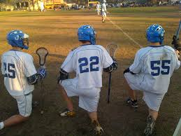
2013 SEASON POI’s
EYE SHADE
SINGLE STROKE WIDTH OF EYE
NO WORDS
CONTACT :
DEFENSELESS PLAYER
CONTACT
HEAD / NECK AREA
PENALTY STACKING
NO MORE THAN 3 PLAYERS IN BOX AT SAME TIME

Slide 20
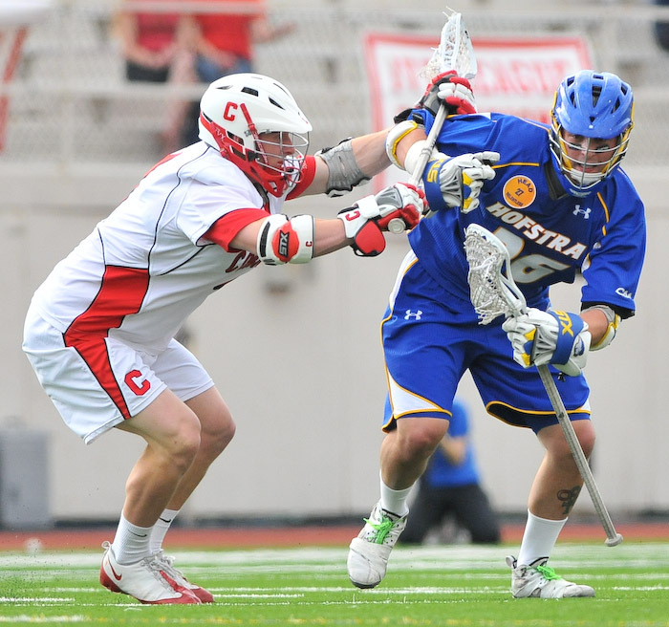
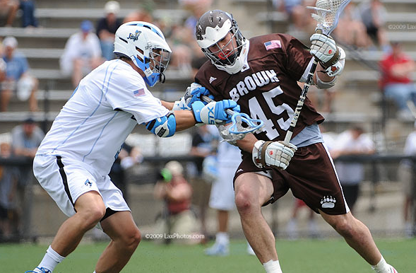
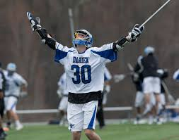
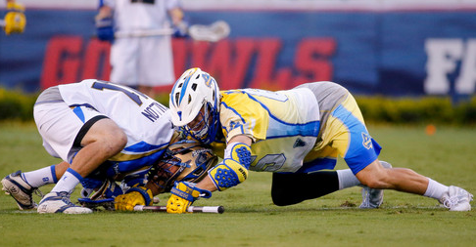
2012 SEASON POI’s
Deliberately Grabbing the Ball with the Hand on the Faceoff – The faceoff technique of playing the ball with the fingers or hand is illegal touching and should be penalized
ILLEGAL CHECKS
Players Calling Attention to Themselves After a Goal – The unsportsmanlike conduct rule states that a player may not call undue attention to himself
Officials are reminded that it is unnecessary roughness to deliver a gloved hand(s) check with a punching blow. Also, when a check is delivered with both hands on the crosse, the contact cannot be with the portion of the handle of the crosse that is between the player’s hands (cross check). Both techniques are being increasingly used, especially by short stick defenders
EQUIPMENT INSPECTIONS

Slide 21
2011 SEASON
SPORTSMANSHIP
Taunting and baiting an opponent is contrary to the basic concept of fair play and honorable competition. Profane language and taunting is exactly opposite the conduct and behavior intended.
BENCH AREA PROTOCOL
COACH’S EQUIPMENT CERTIFICATION
RESTART PROCEDURES
Bench Area Protocol – Coaches are reminded to remain in the coaches’ area at all times during the game. All coaches should remain off the playing field, including during time-outs. In order to achieve optimal field coverage, officials are encouraged to run the sideline during transition play. Coaches standing on or beyond the sideline create a dangerous situation for both the coach and the official.
“Coach, are all of your players legally equipped by rule?” Head coaches are reminded that by responding “yes,” they are certifying that they have fulfilled all of the requirements of Article 1,
PROPERLY MARKED FIELD

