Slide 1
Three-Person Mechanics

Slide 2
Mission of our Mechanics
Position
Safety
Fairness
Consistency
Notes:
Mechanics put officials in the best position to make the necessary calls to keep the game safe and fair by using methods that are easily applied in a consistent manner.
Position – The best spot to be in for most game situations. Hustling to your next spot is one of the best ways to show the clinicians that you are focused on the game and giving your maximum effort.
Safety – Priority number one for all officials in every game. Make the necessary safety calls when you see them.
Fairness – Your technical foul knowledge and game awareness factor heavily in a fair game. Address issues that unfairly give a team an advantage.
Consistency – Endeavor to make the same calls on each half of the field from the first whistle till the last. Communication with your partner is essential to crew consistency for an entire game.

Slide 3
Responsibilities
Lead
Goal
End line
Single
Shooter
Sideline
Counts
Trail
Shooter
Opposite goal
Over and back
S
L
T
Notes:
Lead Official:
Goal is primary responsibility
Roughly one step above or below GLE and covers the end line on contested plays
Single Official:
Primary responsibility is the action in front of the crease
Also watches for late hits after a shot
Responsible for far sideline and all transition counts
Positioned a few yards above GLE and moves toward GLE when the Lead official covers the end line
Trail Official:
Watches the shooter for late hits after a shot
Watches the high crease area
Watches for contested substitutions
Covers the far goal on a long outlet pass

Slide 4
On/Off Responsibility
T
M
S
L
Notes:
On Official: Has a narrow focus that is on the player in possession and surrounding 5 yards. Generally watches for fouls like pushing, holding, tripping, illegal body checks, unnecessary roughness, slashing, and warding.
Off Official: Has a wider view of the play because off ball involves more players in a greater space. Generally watches for fouls like interference, illegal offensive screens, and crease violations (cutters running through the crease), and late hits after passes.
All Officials: The officials move as if they are connected. When one moves out, the other moves in. This is especially important on contested plays near the end line.
Note: The pre-game should be clear on how On/Off calls will be communicated, especially in the transition area between the officials. Typically, if a player is running towards you then you are about to be the On Official.

Slide 5
Goal Scored Left – “Rocking Chair”
S
F
LL
L
T
W
Notes:
Lead Official:
Sounds whistle, runs in, and signals goal while stationary and facing the action in front of the crease
Gets ball from the goal (goalkeeper DOES NOT have to get the ball for you)
Holds onto ball and becomes the faceoff official on single side
Single Official:
Eye contact with Lead Official on all goals, quick nod to confirm before Lead signals goal
Confirms goal scorer while jogging to Lead Left position
Trail Official
Eyes on the shooter
Eyes on benches and substitutes while jogging to Wing position
20-second timer turns on when Faceoff official arrives at Center X
Note: If several goals are scored on one side of the field and the Trail official is in the rocking chair the crew should rotate positions. This involves everyone in the game and gives the Lead and Single some rest.

Slide 6
Goal Scored Right
S
F
LL
L
T
W
Notes:
Lead Official:
Same as when goal is scored on left side
Single Official
Jogs to Wing official position on bench side
Trail Official
Jogs to Lead Left position
Note: Dead ball time is extended and the full game time lengthened greatly when the crew does not hustle after goals. All officials should be in position for the next faceoff within 12 seconds of the Lead Official getting the ball out of the goal. Work to ensure that players never wait on the officiating crew for the next faceoff.
Note: It is vitally important that all officials keep their eyes on the players and the bench area after goals. Run to your next position for the faceoff and only then pull out your scorecard once you are satisfied that substitutions have settled down.

Slide 7
Ball to Lead Left Official
S
F
L
LL
W
T
Notes:
Faceoff Official:
Only official that physically moves a player’s body or crosse
Places ball between both heads and says “set” with hand on crosse
Sounds whistle while backing away.
Lead Left:
Verbally instructs players and informs Faceoff official when he is satisfied
Moves away from the faceoff X to a comfortable position
Wing Official:
Gives ready signal when field is set
5 yards in and 5 yards off the wing line
Open to both wings
Pays greater attention to a wing where the players are set up closer together
Note: The Lead Left is an active participant in setting up the correct faceoff positioning and must make violation calls if he sees them. This official only gives verbal instruction and should not physically adjust players.

Slide 8
Ball to Wing Official
S
F
LL
T
L
W
Notes:
Note: Depending on the faceoff it may be best for the Lead Left official to stay on a straight line facing both faceoff players. This keeps Lead Left in a good position to see either player creep into the neutral zone as the Faceoff Official moves backwards. Only set up like this if you are comfortable being in the middle of the field and if neither player has been pushing the ball forward because you have a greater chance at being stuck in the middle of the play.
Note: In a close game with little time on the clock it may be good to have the Faceoff Official conduct the entire faceoff with LL and W closer to the top of each attack box on the bench side of the field. That way the crew can more easily cover the goal on a quick shot off of the faceoff.

Slide 9
Crease Play
M
S
L
Notes:
Lead and Single:
Player running at you: Watch the feet. You have a better view of the feet and the crease
Player running away from you: Watch the body. You have a better view of the players converging on the ball carrier
Sell the call:
If you have a crease violation or a push into the crease you need to sell the call. Let everyone know exactly what your call is
Close goals:
Lead official has the whistle when covering the goal and should always look to the Single for a quick nod to make sure the goal is good before signaling
“It is better to be slow and right than fast and wrong.”
– Author Unknown

Slide 10
Crease Play
M
S
L
Notes:
Single and Lead work as a team to ensure that the goal and crease area are always covered. As the Lead runs toward the end line to cover a contested play the Single drops closer to GLE to help with any close crease calls while the Lead is below the goal.
Note: Typically the Lead official will signal goal, but if the Lead is on the end line and there is a quick pass to above GLE and goal is scored then the Single is in the best position to call and signal the goal. As with every goal, the two officials should look toward one another and nod before the goal signal is given.

Slide 11
Slow Break
S
M
T
L
Notes:
New Lead Official:
Starts backing up while keeping eyes on the play
Gets to one line ahead of the ball and scans the field
Stays one line ahead of the ball during the slow break until reaching GLE
Single Official:
Has the 20-sec and the 10-sec count (NFHS) or 30-sec count (NCAA)
Moves outside the developing play and follows it up the field
Pauses at the cone until players cross and makes sure there is no offside
New Trail Official:
Has the 4-second crease count
Behind the ball as the clear develops

Slide 12
Fast Break
S
M
T
L
Notes:
New Lead Official:
Goal coverage is the most important thing. You must be in position and on or near GLE to sell the call
Sprint to cover the field, do not focus on offside. Instead allow partners to pick up the offside
Single Official:
Sprint past the cone and keep your focus on the players in transition.
It is a two-person game until the Trail is in position, and the focus must be on any late hits after passes or shots on the opposite half of the field.
Has the transition count
New Trail Official:
Has the 4 second crease count
Make sure all additional action has ceased and then run up to near the midline
Check for offside (count forward)
Jog to your position above the top corner of the attack box
Note: Support your partners. Hustle to your next position and tell your partners that “You’re in!” so they can focus on their main responsibilities as the Lead and Single.

Slide 13
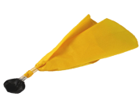
Penalty Relay
S
Relay
M
D
L
T
C-NOTE
Notes:
Official witnessing penalty throws flag and yells “flag down!” Partners echo the call.
Stop play when the rules require you to do so.
After stopping play:
Confirm foul and penalty time with partners
Trail reports the foul and uses C-NOTE
Partners set the field for the restart and inform the goalkeeper on the length of penalty and where the ball will restart
Before restarting play:
Confirm when the penalty will release from the clock
Ex. “all even at 6:15”
Count both teams
Note: It may be necessary to walk into the table area to confirm multiple penalties or more complicated situations with the penalty timer.

Slide 14
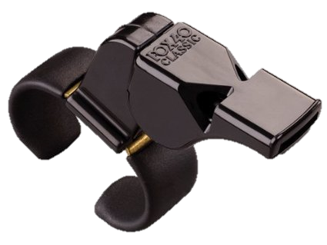
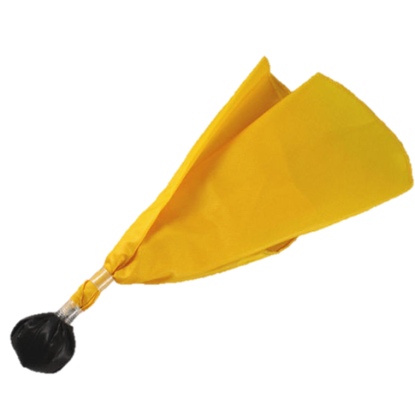
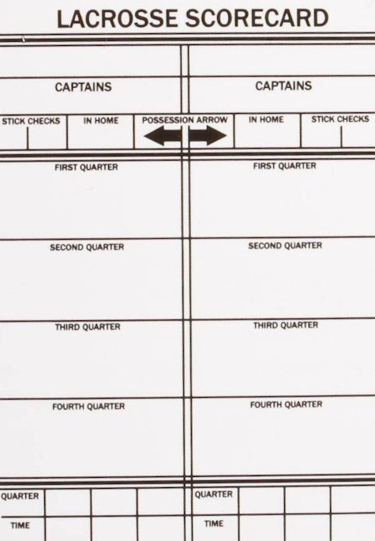
Fights
Fight!
S
M
D
L
Freeze!
T
Notes:
Closest officials:
Run toward the players fighting and continuously circles while blowing the whistle. This keeps other players from entering into the fight and a whistle blown loudly at close range will get the attention of the fighting players. Communicate that you want the players to stop fighting in between whistle blasts.
Note: Physically separating players should only be done if you judge that you can do so without endangering the safety of the players or yourself.
Furthest official:
Get to a space near the benches and loudly shout “Freeze!” while spreading your arms. Repeat that often and instruct the coaches to assist you in keeping the players in their bench areas. Once the benches are frozen turn to your partner and record the numbers of all players involved in the fight.
“If they played by the honor system, they wouldn’t need us.” – Author Unknown

Slide 15
uslacrosse.arbitersports.com
facebook.com/menslaxofficials
Notes:
The US Lacrosse Central Hub at uslacrosse.arbitersports.com is your one stop shop for men’s officiating memos, articles, videos, downloadable resources, and rules tests. You can also find applications to this year’s LAREDO clinics.
Follow the Men’s Officials Education Program on Facebook at facebook.com/menslaxofficials

