Slide 1
TECHNICAL FOULS
Keystone Lacrosse Officials Association
April 10, 2017
Conestoga High School
T. J. Antich

Slide 2
SECTION 1 - DEFINITION
Fouls of a less serious nature and include all violations of the rules of the game except those specifically listed as personal or ejection fouls
Penalty for a technical foul:
30-second time serving penalty if the team fouled had possession, or
Awarding the ball to the team fouled, if the team fouled did NOT have possession of the ball at the time the foul was committed.

Slide 3
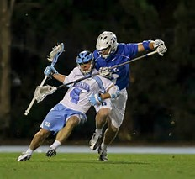
RULE 6 – NFHS BOYS LACROSSE BOOK
How many different categories of Technical Fouls are listed in the 2017 Rule Book ?

Slide 4
RULE 6 – NFHS BOYS LACROSSE BOOK
How many different categories of Technical Fouls are listed in the 2017 Rule Book ?
11

Slide 5
HOW MANY DIFFERENT TECHNICAL FOULS CAN YOU NAME ?
1 – Crease Violations / Goalkeeper Interference
2 – Holding
3 – Illegal Offensive Screen
4 – Illegal Procedure
5 – Conduct Foul
6 – Interference
7 – Offside
8 – Pushing
9 – Stalling
10 – Warding Off
11 – Withholding Ball from Play

Slide 6
SECTION 2 – CREASE VIOLATIONS / GOALKEEPER INTERFERECE
(A) Defensive Team in Possession of the Ball OUTSIDE the Crease
RULING: Slow Whistle, Flag Down – Allow Defensive team to continue their possession until they either score, the ball hits the ground, or THEY commit a foul.

Slide 7
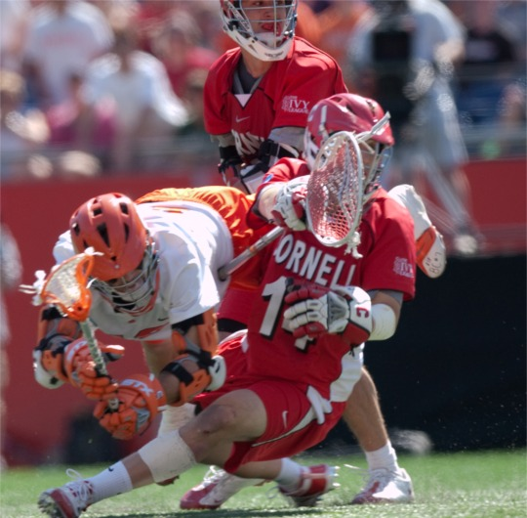
SECTION 2 – CREASE VIOLATIONS / GOALKEEPER INTERFERECE
(B) Ball and Goalkeeper in the Crease, regardless of Possession or Loose Ball
RULING: Play On.
If Possession: Entitled to a Free Clear at the Least
If Loose: Entitled to Possession at the Least

Slide 8
SITUATION
Goalkeeper makes a save in the Crease,
Riding attackman outside the crease poke checks the Keeper’s crosse,
Official signals “Play On”,
Keeper attempts to make an outlet pass and ball hits the ground.
WHAT DO YOU DO ?

Slide 9
SITUATION
Ball is loose in the Crease. Keeper has ball clamped.
Riding attackman checks Goalkeeper’s stick.
Official signals “Play On”.
As Keeper attempts to scoop the ball, Attackman slaps the ball INTO THE GOAL.
No whistle was ever blown.
WHAT DO YOU DO ?

Slide 10
SITUATION
Keeper makes a save and outlets the ball to his Defenseman at Goal Line Extended (GLE)
Riding attackman initially playing the Goalie cuts through the crease in order to chase after the Defenseman and the ball.
HAS ANY VIOLATION BEEN COMMITTED ?

Slide 11
SECTION 3 - HOLDING
A PLAYER SHALL NOT IMPEDE THE MOVEMENT OF AN OPPONENT OR HIS CROSSE.
Cannot step on the crosse of an opponent,
Cannot hold an opponent with your crosse,
Cannot hold an opponent with your free hand
Cannot use your crosse to hold or pin an opponent’s crosse to the ground on a face-off

Slide 12
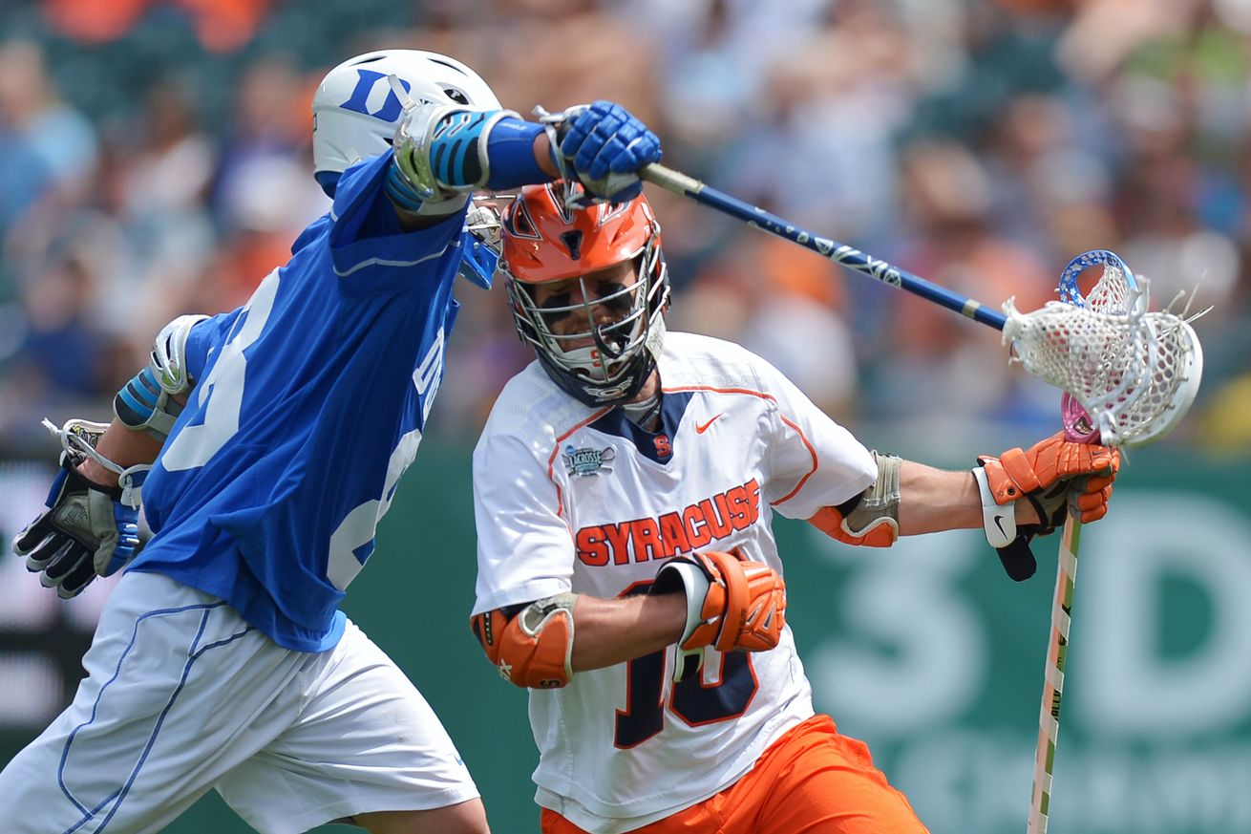
THERE ARE LEGAL HOLDS ! ! !
Body-to-body from front or side within 5 yards of a loose ball (“Man-Ball”)
Player with possession of the ball by a defender’s closed hand, shoulder, or forearm as long as both of the defenders’ hands are ON his crosse,
Stick-on-stick hold when a player has possession of the ball, and
Stick-on-stick within 5 yards of a
loose ball

Slide 13
SITUATION
Red and Blue players both going for a loose ball with Red player having a slight advantage,
Red player touching the ball and trying to pick it up but Blue player impeding his ability using his stick on Red player’s stick to prevent him from doing so.
WHAT DO YOU DO ? Is it a Play On, a Flag Down, or an Immediate Whistle ?

Slide 14
IS THIS A HOLD ?
Body on body as long as both of defenders hands on his crosse
Both players are within 5 yards of a loose ball !?!?!?

Slide 15
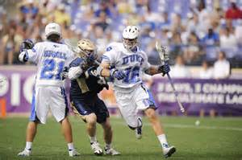
SECTION 4 - ILLEGAL OFFENSIVE SCREEN
Please don’t say “Moving Pick
Player setting the screen must be STATIONARY . . . Like a “Statue”,
Crosse must be kept within the frame of his shoulders,
Feet may be no further apart than the shoulders,
Any movement of player setting the screen is a VIOLATION

Slide 16
SITUATION
Red team has the ball. Blue team playing defense.
Red teammate sees Blue defender and jumps in place next to him to set a pick for the Ball Carrier.
He lands and his FEET ARE SET. Red player’s momentum bumps Blue defender as he is playing the Ball Carrier.
AGAIN, Red player setting the Screen HAS HIS FEET SET.
WHAT DO YOU DO ?

Slide 17
SECTION 5 – ILLEGAL PROCEDURE
Any action on the part of players or substitutes of a technical nature that is NOT in conformity with the rules and regulations governing the play of the game.
There are 24 types of Illegal Procedure violations listed in the 2016 NFHS Boys Lacrosse Rule Book.
There is ONE new Illegal Procedure violation listed in the 2017 NFHS Boys Lacrosse Rule Book. What is it ?

Slide 18
SECTION 6 – CONDUCT FOUL
Can be called on players
Can be called on coaches
Can be called on other team personnel on the sidelines
Leaving bench area on his side of the field
Object by arguing or gesturing a decision by an official
“Commit any act” considered misconduct by an official
What constitutes 30-second conduct foul vs. 1-min NR Unsportsmanlike Conduct Foul ? ? ?

Slide 19
SECTION 7 - INTERFERENCE
More than five yards away from the ball
Preventing any free movement of an opponent, EXCEPT when opponent has possession of the ball
Watch for defenders in front of the crease “bodying up” on offensive players. Officials should yell, “Let ‘em move”
Goalkeeper with long outlet pass to midfield. Defender checking attackman’s stick as soon as GK releases ball constitutes interference.

Slide 20
SECTION 8 - OFFSIDE
More than 6 players in offensive half of field (including players in penalty box) . . . Or . . .
More than 7 players in defensive half of field (including players in penalty box)
Can a team play with TOO FEW players on either side of the field ?
Watch for illegal substitutions from the box
Officials responsible for ensuring correct count at face-off, man up / man down, after timeout and after injury.

Slide 21
SECTION 9 - PUSHING
Thrusting or shoving an opponent from the rear. Exerting pressure after contact is made but NOT a violent blow.
Pushing IS PERMITTED from the front or the side with opponent either HAS the ball or is within 5 yards of a loose ball.
Must be done with closed hand, forearm, or shoulder, and with BOTH HANDS on the cross

Slide 22
SECTION 10 - STALLING
Team in possession MUST attack the goal,
“Keep It In” – Judgement by officials that team with ball is keeping the ball from play by NOT attacking the goal.
Defensive team MUST be attempting to play ball in the goal area for stall warning to be issued
Stall warning remains in effect until ? . . .
(a)
(b)
(c)

Slide 23
SECTION 11 – WARDING OFF
Use of free hand, arm, or any other part of his body to HOLD, PUSH, or CONTROL THE DIRECTION of the movement of the crosse or body of the player applying the check. A player may PROTECT his cross with his hand or arm.

Slide 24
SECTION 12 – WITHHOLDING BALL FROM PLAY
LOOSE BALL – Lying on the ball
LOOSE BALL – Clamping ball with crosse longer than necessary to control the ball and pick it up with one continuous motion
POSSESSED BALL – Attacking player clamping ball in his crosse to his chest
POSSESSED BALL – Attacking player “thumbing” the ball in the crosse / touching the frame of the stop

Slide 25
FOR FIRST YEAR OFFICIALS:
A “clamped” ball is a:
(a) loose ball,
(b) possessed ball,
(c) lacrosse ball,
(d) jump ball

Slide 26
FOR FIRST YEAR OFFICIALS:
Red player in possession of the ball is “pushed” from behind by a Blue player.
WHAT DO YOU DO ?
(a) Immediate Whistle
(b) Flag Down
(c) Signal a “Play On”
(d) See whether or not the Red player is disadvantaged

Slide 27
Thank You ! ! !

Slide 28
LACROSSE IS A BEAUTIFUL GAME
2014 FIL World Lacrosse Championships, Denver, CO

