Slide 1
Last 5 mins of the game:
Topics for awareness & discussion with your partners;
What are you thinking about?

Slide 2


Where I’m stopping on the way home?

Slide 3
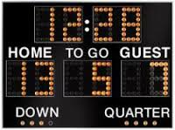
Situations
Timeouts
Consistency
2:00 Mins Keep it in or NOT

Slide 4
Situations
Tight game Vs Blowout
Weather - Thunderstorm protocol, resume game / suspend game - write it all down: score, time, t/o, where the ball was.
Foul trouble - anyone with 4 mins worth of personals, or 1 unsportsmanlike?

Slide 5
Timeouts
Whose got them and how many?
Overcommunicate with Coaches - “ Coach you have one timeout left, they have two.”
Team that calls the timeout says they are ready go, blow the whistle, start your timer, get’em back on the field.

Slide 6
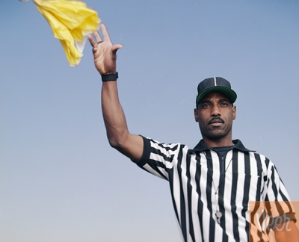
Consistency
#1 compliant from Coaches regardless of game time
Slash in the 1st qtr better be a slash in the last 5 mins too.
A push is a push is a push.
Our job is to keep it safe and fair.

Slide 7
Get it in, Keep it in??
New Rule for 2017 6-10-3
Last 2 minutes, in 2017, Stalling rule is ONLY in effect if the difference in goals is 4 or less. 5 or greater no one has to keep it in.
Overcommunicate this too. Old habits die hard, coaches and players will be yelling to keep it in. And complaining if the other team doesn’t

Slide 8
Questions – or other topics to consider?

