Slide 1
Game Management

Slide 2
Major Principles
Early Control
Proper Warnings
Consistency
Avoid Coaching
Notes:
Good Warnings:
“Off the line gentlemen” = speaks to both teams
“Easy” = vague enough to apply to any situation involving body and stick contact
Warnings that coach a player for one team:
“Blue get your right foot off the line” = telling the blue player that he is doing something illegal without penalizing him
“Red, stop slashing” = tells the blue coach that you passed on a slash
Class Question
What if I am not comfortable giving verbal warnings? Communication is one of the most valuable attributes of top officials. If you are not comfortable saying certain things, then find a way to communicate that you are comfortable with.

Slide 3
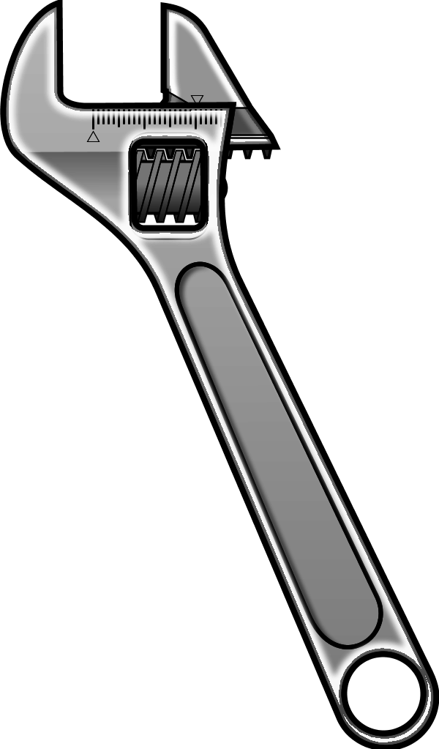
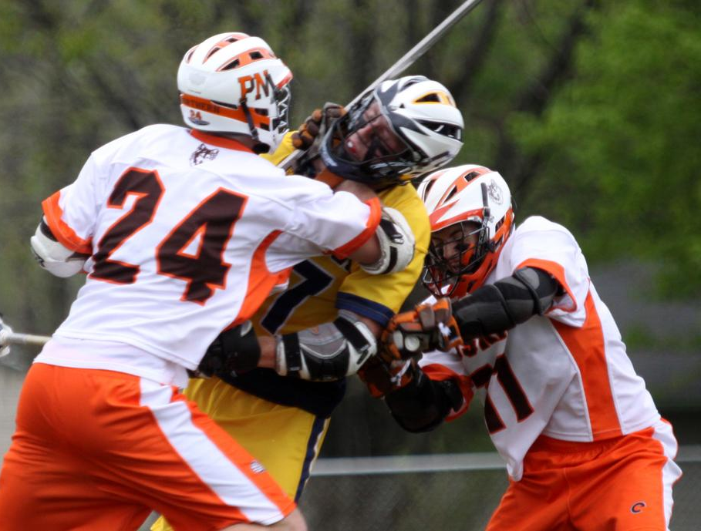
Early Control
Easy to Tighten
Hard to Loosen
Remember you are in control of the game
Notes:
Early control prevents escalation and later problems
Tighten up on player control violations to prevent personal fouls
Dangerous situations: loose ball scrum, players getting tangled, goal scored, retaliation contact
Be consistent – a slash passed on in the 1st quarter should not be called in the 4th
Class Question
How do you respond when a coach asks how you will call the game? Should you say you call it tight or loose? Do not say you call tight or loose because it puts an expectation in the head of the coach that will never match the reality of a game yet to be played. A better response is: “Coach we’re going to let the players play until they show us they can’t.”

Slide 4
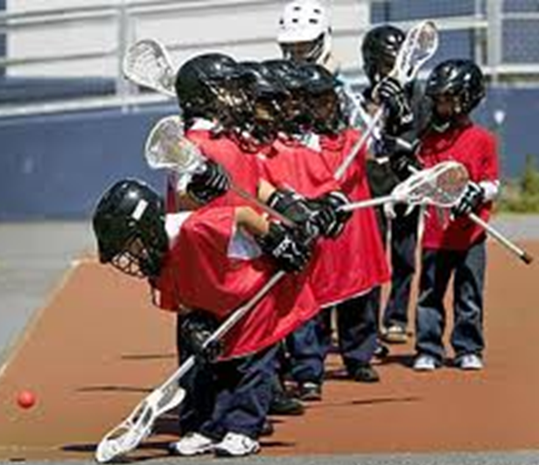
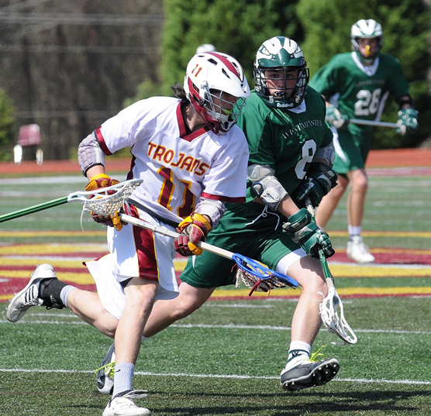
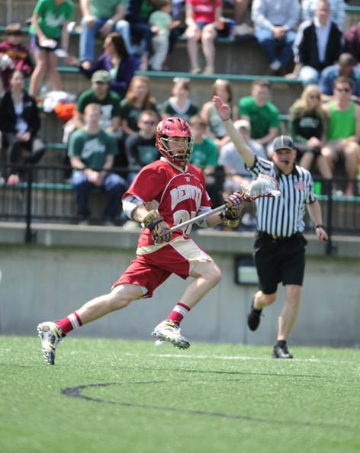
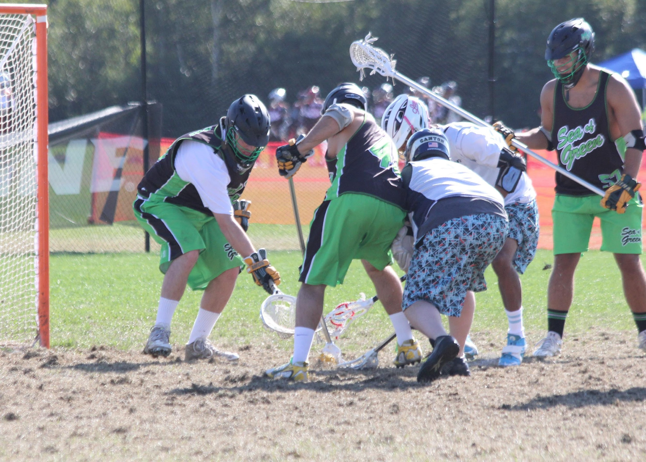
Caliber of Play
Notes:
Threshold for calls varies
Consider level of play
Youth
High school
College
Men’s club
Class Question
Why is US Lacrosse and the NFHS getting rid of hitting in boys’ lacrosse? Lacrosse is a finesse sport with contact, not a collision sport. New definitions for illegal hits were added over the past several years due to new science showing how devastating blindside hits and checks to the head or neck are. As officials you are there for the safety of the players first and your threshold for violent contact must match the appropriate age guidelines for the players.

Slide 5
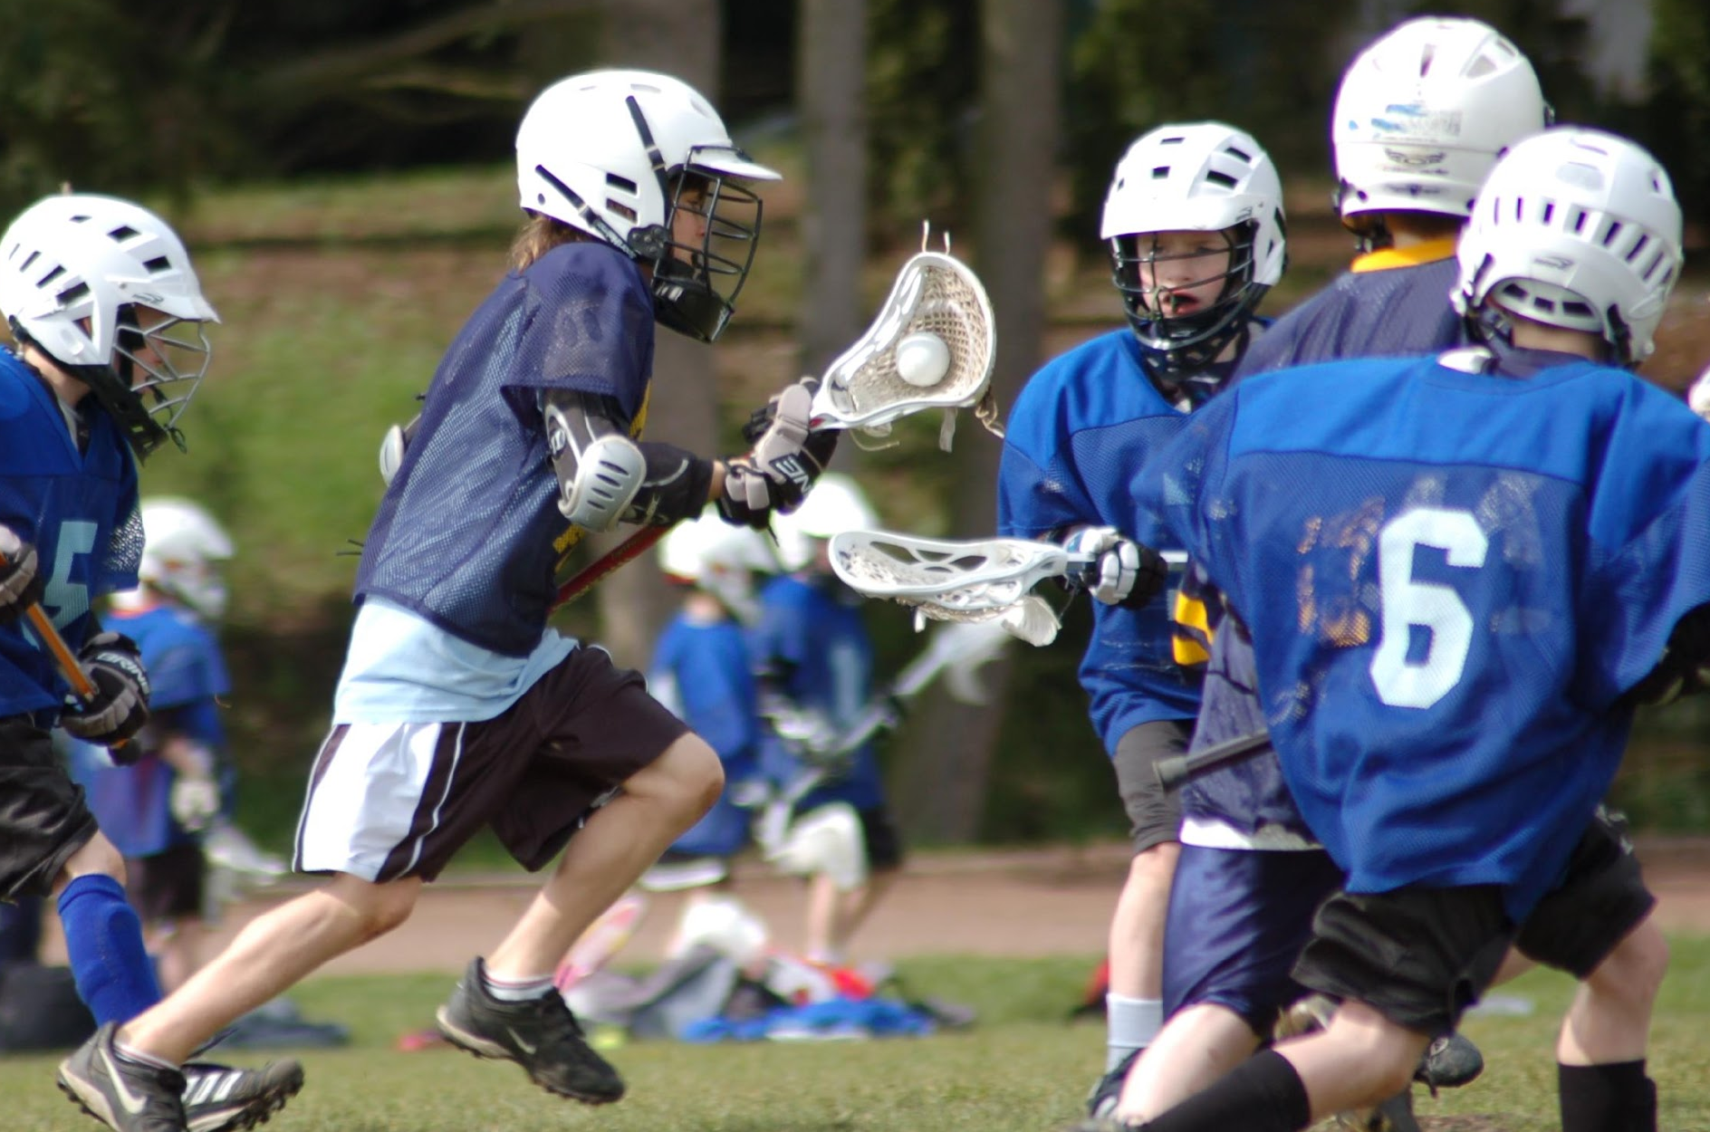
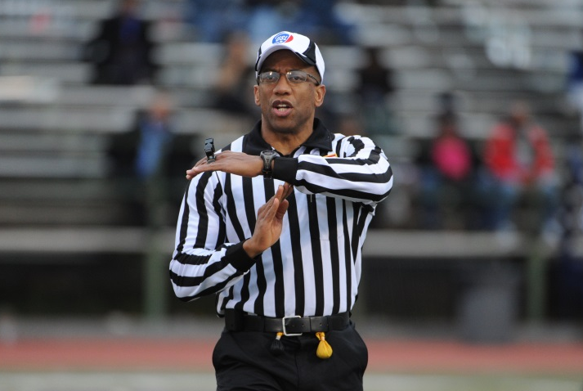
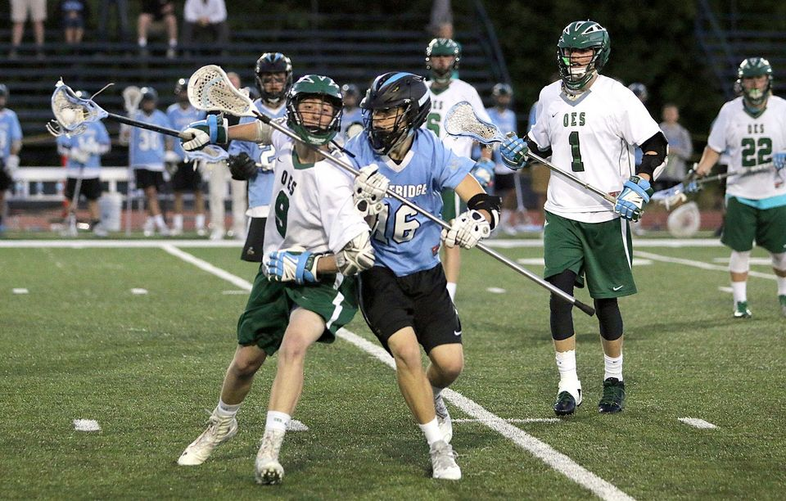
Technical Fouls – A great way to manage the game
Notes:
Good officials use technical fouls to manage the game
Flow
Players
Coaches
Caliber of play considerations
Low level – you can’t call them all
High level – every possession counts
Class Question
When is it appropriate to downgrade a personal foul to a technical like when officials call a hold instead of a trip? This is only done when the official knows a foul occurred and is 50/50 on safety and fairness. In these situations it may be appropriate to call a technical foul. If done so the crew must communicate this to stay consistent later in the game. This leads us to the next slide.

Slide 6
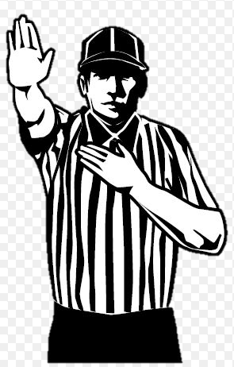
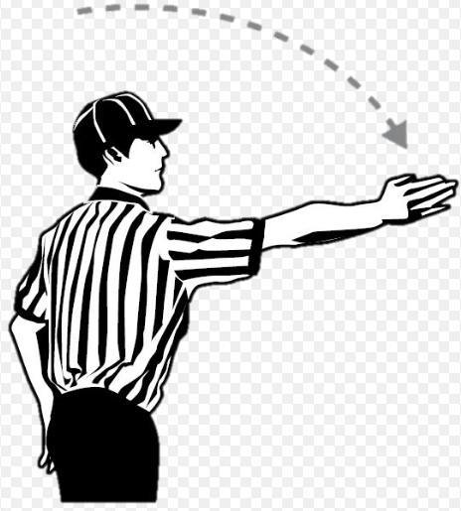
Say it all with fewer words
Say enough to make the call – and that’s it !!!!
“Push!- RED Ball!”
Is far more effective than
“Ball was loose, White #15 pushed Red #22 in the back, Red ball”
Get the ball live again quickly!!!
PUSH!
RED Ball!
Notes:
Pay attention!
Do the participants understand your call?
Illegal procedure – why?
Caliber of play considerations
Low level – explain the call to the player who committed the violation
High level – explain the call to the coach who the call was against (or even both coaches if confusion reigns)
Class Question
Are you obligated to explain a call to a coach or player? No, however making use of the dead ball time after penalties or between quarters to explain why a penalty was called may help prevent a future penalty.

Slide 7
Sometimes Explanations are needed
Quality game mangers know when an explanation is necessary.
Know the situation, the call you have made and why you made it.
If explanation is required, make it quick and concise.
Examples
Multiple fouls or Multiple flags
Crease play
Contested out of bounds play
Other examples???

Slide 8
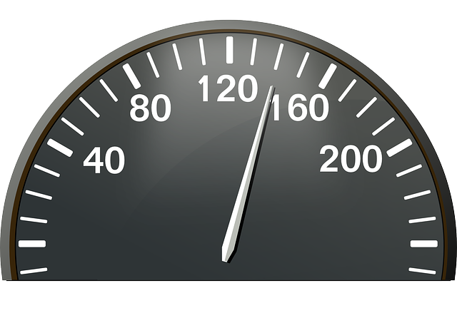
Improve Flow – Keep the ball in play
How do we get the play resumed quickly?
What is the call? – Communicate with hands and words
Who gets the ball? – Point in the proper direction
Where is the restart?
After a goal, the players should not be ready before us.
Jog to the “X” – wing/right official should start timer when faceoff official(s) is ready. If the players see us ready, they are more likely to get into position more quickly.
Jog to position
Use timer
Notes:
Dead ball time is only as long as the officials allow
Ways to keep the game moving:
Non-reporting official sets the ball and informs players of the situation
All officials jog to the next face off after ball exchange
Communicate the three important facts:
What is the call?
Who gets the ball?
Where is the restart?
Class Question
What are all of the situations where you would use your timer? Timeouts, after reporting a penalty, after an injury, after an equipment adjustment, between quarters (regulation and OT), before a faceoff.

Slide 9
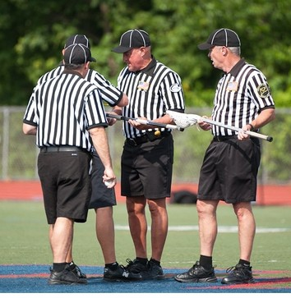
Stick Checks
When is the right time to perform a stick check?
- Time-outs, End of quarters (not halftime)
What are the procedures when checking a stick?
Measurements:
- Depth of pocket (Cannot see entire ball below sidewall)
- Width of head at the top (6 1/2 “ minimum)
- Length of head (10” top of head to throat)
- All shooting strings within 4” of top of head
- Midfielder/Attack sticks between 40”-42”
- Defensive sticks between 52”-72”
- Goalie stick between 40”-72”
Ball freely releases when tested:
- Tip stick forward
- Tip stick to right and left (ball comes out the side)
- Tip stick upside down and take to vertical
Ultimately, the referee on the game decides if a stick is legal/illegal
Illegal stick penalties:
- Pocket too deep = 1 min. NR penalty (stick can be fixed and returned to the player)
- Measurement infractions and/or ball does not freely release = 3 min. NR penalty – Stick is placed at table and cannot be retrieved until the game is OVER. Only penalize most sever infraction. (I.e. Deep pocket and ball not releasing = 3 min. NR penalty)
Violations that do not result in time serving penalty – no butt end on stick, end not designed for use on a lacrosse stick (i.e. a beer bottle cap), hanging strings longer than 2” off stick, tape ring more than 3” from the butt end of the handle.
Crew Controls Stick Checks

Slide 10
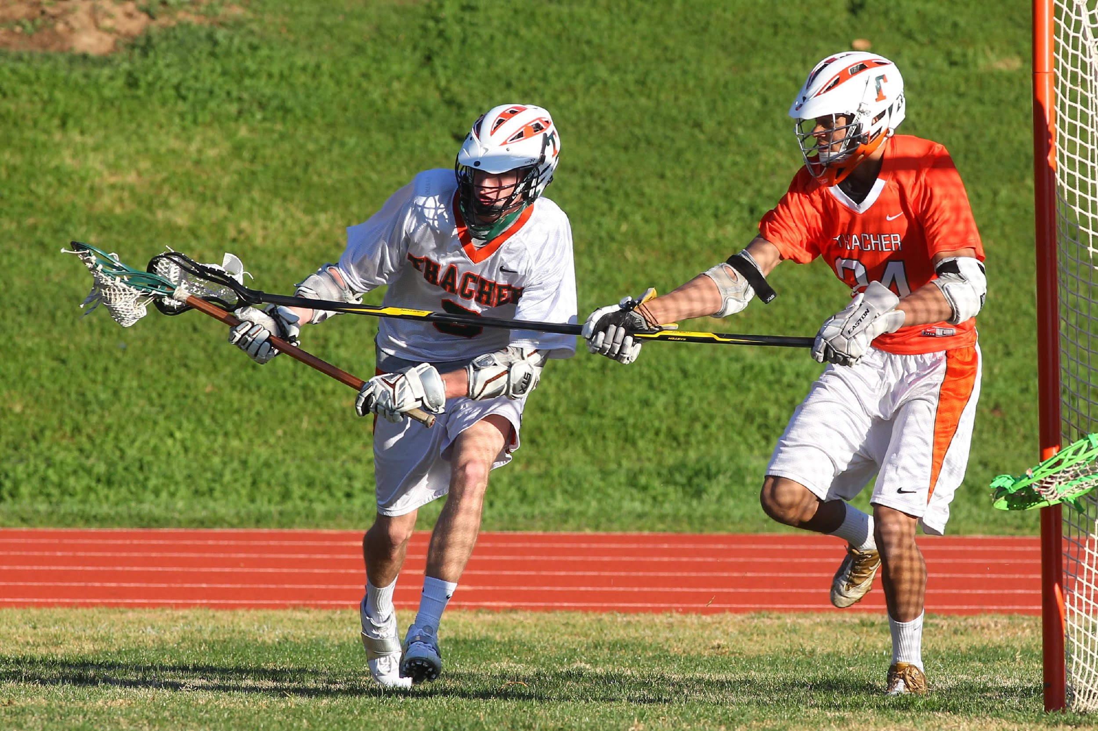
Managing Players and Coaches
Define the edge
Intention vs. ineptitude
Prevent something worse
Find teachable moments
Sportsmanship
Notes:
Class Question
Each of these topics will be covered in the next few slides. Before going to them ask the class what they think each of these phrases means.

Slide 11
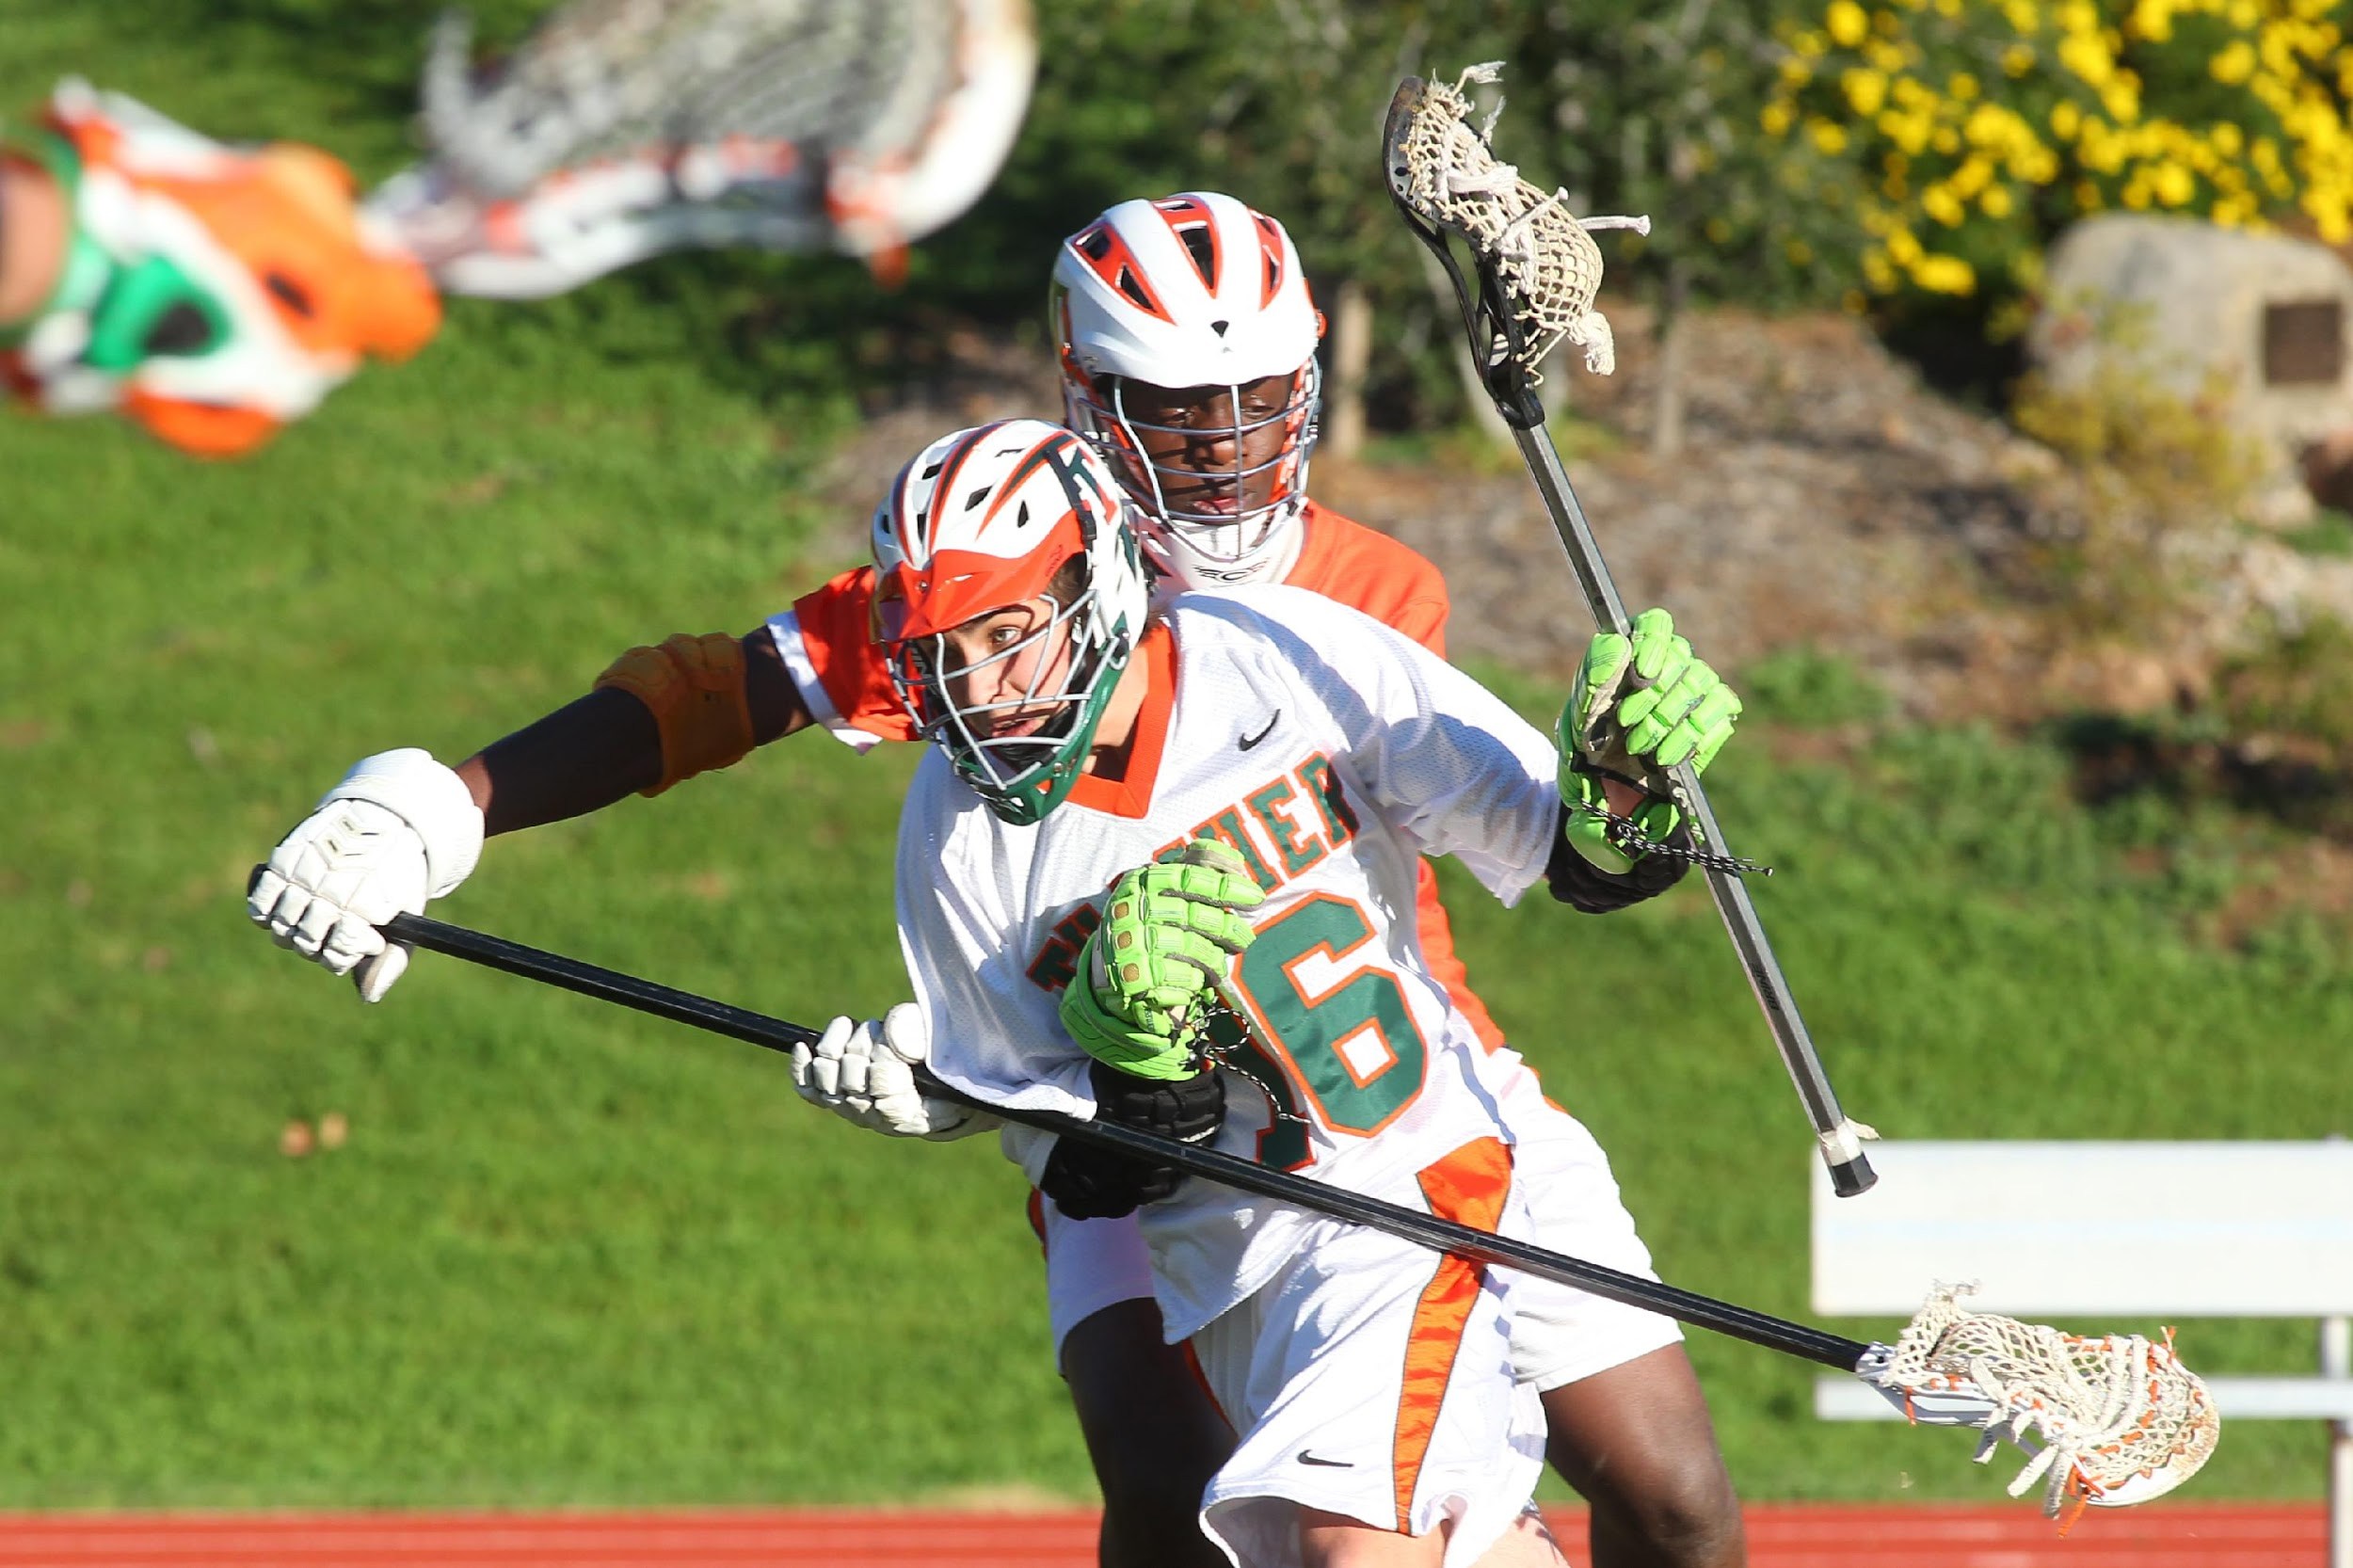
Define the Edge
Legal?
Illegal?
How do you determine?
Notes:
Actions speak louder than words
Signal violation
Give possession to opponent
Award penalty time
Caliber of play considerations
Low level
Do players listen to coaches?
High level
Do coaches want you ‘coaching’?
Class Question
Is the contact in this picture legal or illegal? Whether you do or do not have a call with the image in this slide you must recognize that early in a game whatever you call or don’t call establishes whether or not similar contact will or will not be called later in the game.

Slide 12
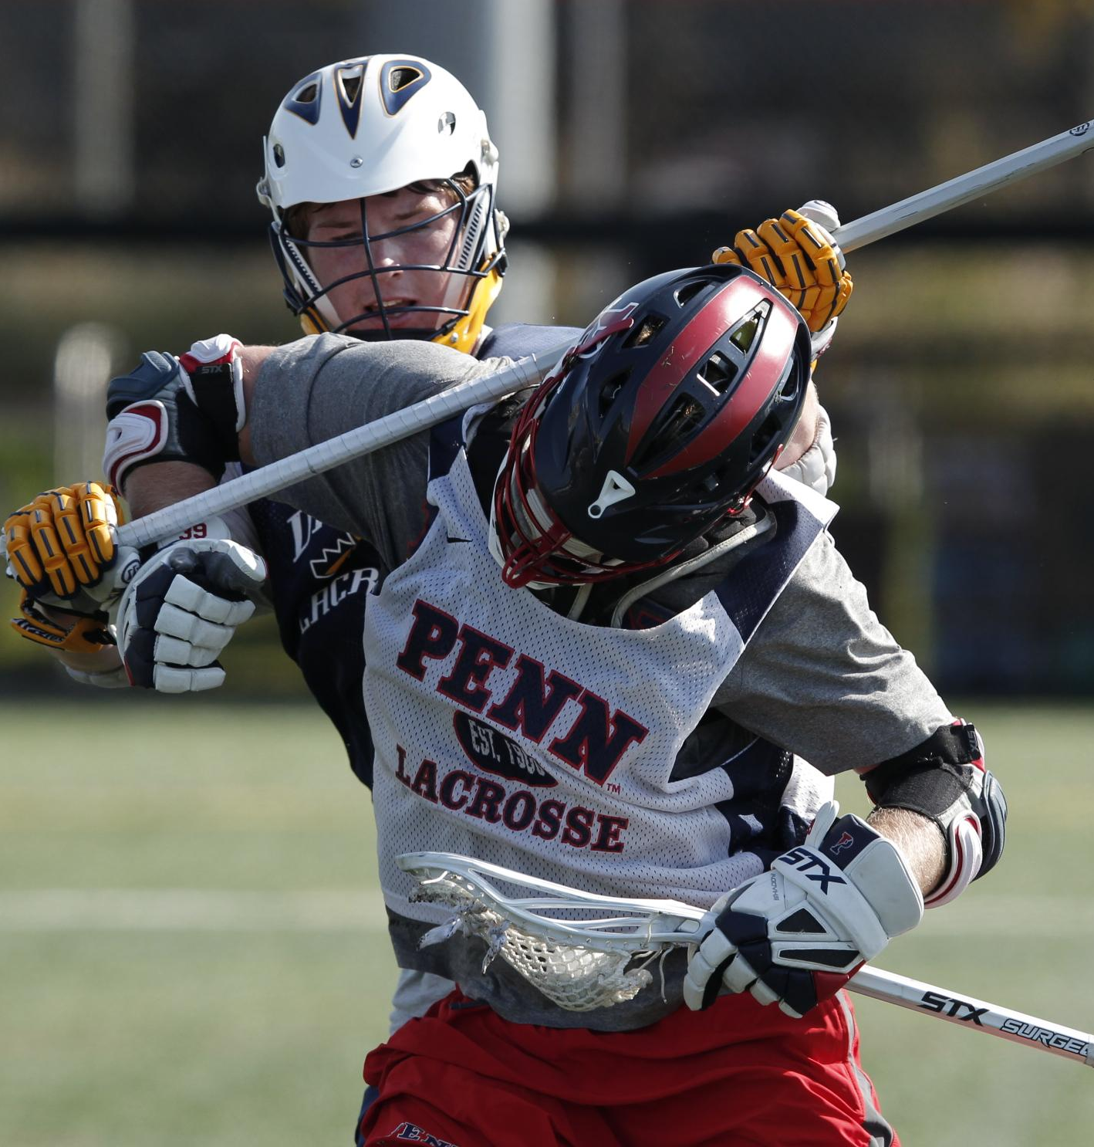
Intention vs. Ineptitude
Notes:
Caliber of Play considerations
Low level
Only penalize inept play that creates a significant advantage
High level
Let players know that you see what they are doing
Penalize intentional violations that create small, but crucial, advantages
Class Question
How should you let a player know that they should stop doing something? Dead ball time is usually the most effective. A quick word with a player that you saw them do something foolish and you are watching them closely as a result.

Slide 13
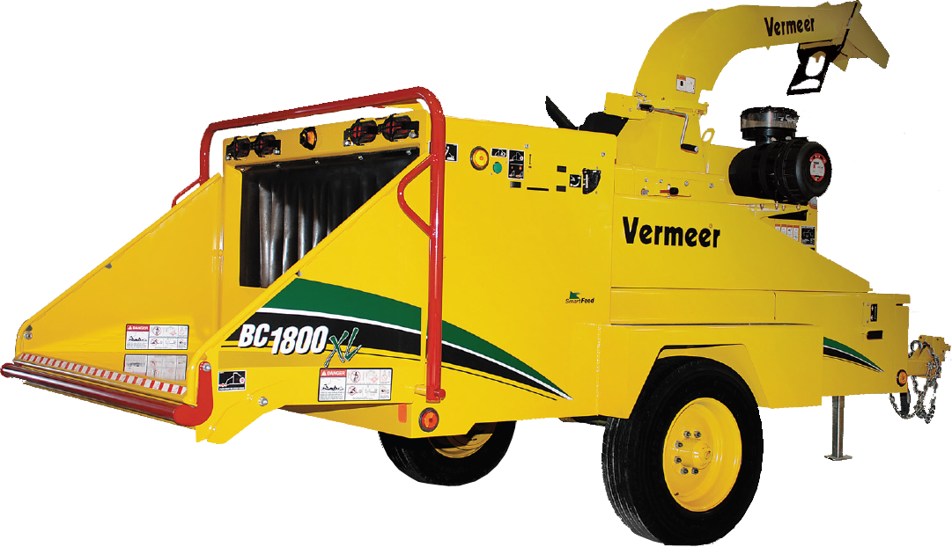
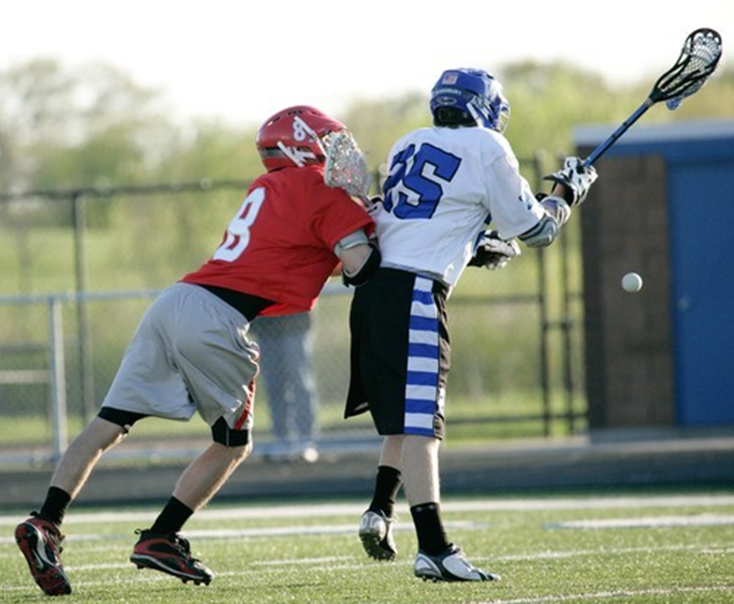
Prevent Something Worse
Short Play-On!
Notes:
Pay Attention – is play “chippy”?
If so –
Tighten up on player control violations to prevent personal fouls
Keep “play-on” interval very short, to prevent escalation or retaliation
Opportunities
Loose ball scrums
Contact around the crease
Two players get tangled up
Class Question
Why a short play-on if play is getting chippy? Most retaliatory fouls occur because the players feel violated and may not realize that a penalty was already called on their opponent. A shorter play-on means a faster whistle and the player can more quickly realize that play is over and they have a moment to breath and realize that they are getting the ball and not to do anything foolish during the dead ball.

Slide 14
Sportsmanship – The Ramp
Ejection!
USC 3-minute NR
USC 1-minute NR
Conduct foul while opponent has possession
Conduct foul while in possession
Warning
Notes:
Answer polite questions from coaches
Use the conduct foul “ladder” to manage the benches
Opportunities
Coach leaves coach's area to confront you
Head coach is impolite / unprofessional
Assistant coach tries to influence you
Maligning comment from bench area
Class Question

Slide 15
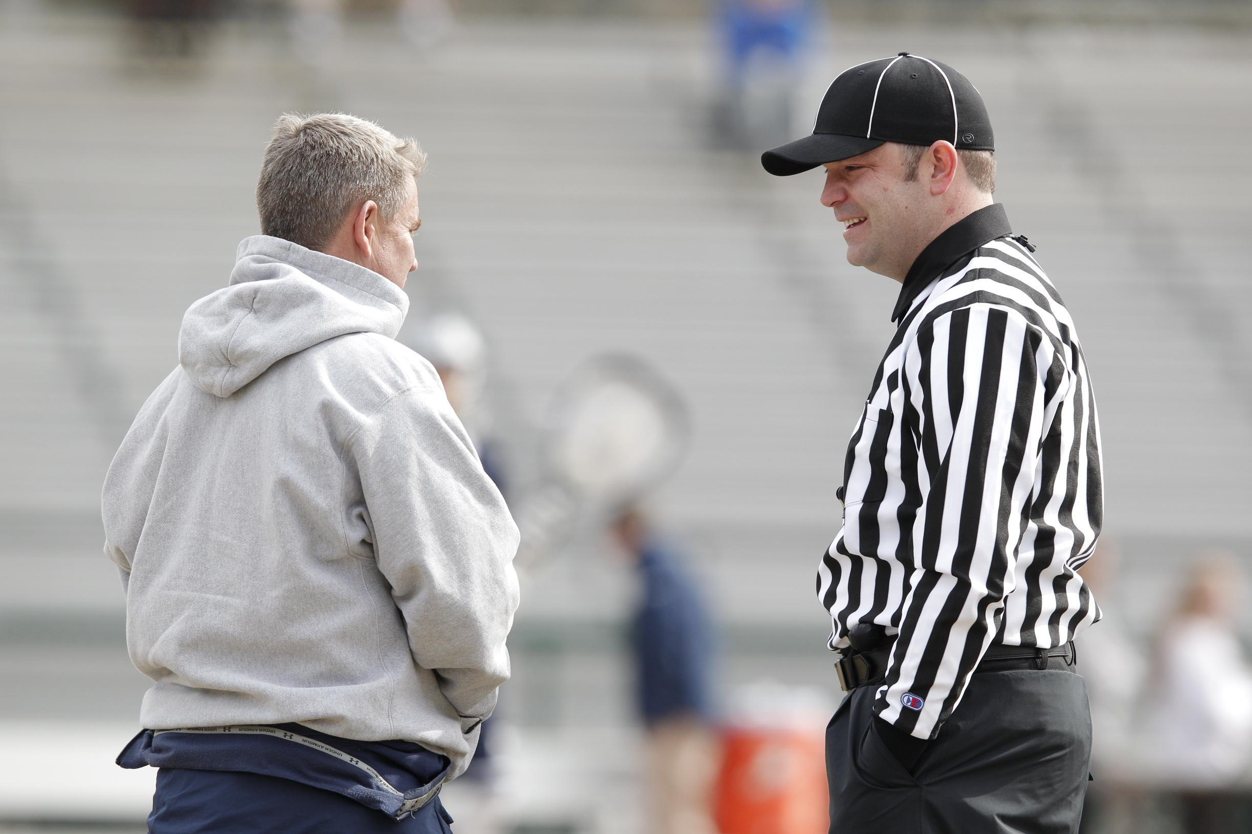
Game Management
Relaxed
Smiling
Confident
Happy
Approachable
Professional
Notes:
Relaxed
If you are relaxed the coaches and players around you will pick up on it and relax themselves.
Confident
Know the rules and the mechanics. Stand tall and you’ll have half of the battle already won.
Approachable
No one likes an official who they can’t talk to. Be willing to answer questions and be willing to end the conversation if it goes overboard.
Smiling
A genuine smile can disarm an angry individual.
Happy
You are on a lacrosse field officiating. What could be better? Show your excitement to be there that day. The coaches and players will appreciate it.
Professional
Act in the manner of a consummate official in all of your on and off-field interactions and you will go far.
Your Demeanor is Key!
Class Question
How do I know when I should flag a coach or player for poor behavior or a negative comment directed at me? Ask yourself one question – “Does throwing my flag in this situation make the game better?” If yes, throw it. If no, keep it in your pocket.

Slide 16
Questions?
Comments?

Slide 17
uslacrosse.arbitersports.com
facebook.com/menslaxofficials
Notes:
The US Lacrosse Central Hub at uslacrosse.arbitersports.com is your one stop shop for men’s officiating memos, articles, videos, downloadable resources, and rules tests. You can also find applications to this year’s LAREDO clinics.
Follow the Men’s Officials Education Program on Facebook at facebook.com/menslaxofficials

