Slide 1
2014 NFHS Boys Lacrosse Rules Interpretation Meeting Keystone Lacrosse Officials Assn Ed Cavaliere Rules interpreter

Slide 2
Concussion in Sports – What You Need to Know www.nfhslearn.com
FREE!
Notes:
175,000+ since July 1.

Slide 3
www.nfhslearn.com
Fundamentals of Coaching Lacrosse
Courses available for both boys and girls
Developed in partnership with the NFHS and US Lacrosse.
Designed for lacrosse coaches to learn how to teach the skills and tactics of the sport.
Learn more about this course and other great courses from the NFHS at www.nfhslearn.com!

Slide 4
NFHS Boys Lacrosse Rules
Each state high school association adopting these NFHS boys lacrosse rules is the sole and exclusive source of binding rules interpretations for contests involving its member schools. Any person having questions about the interpretation of NFHS boys lacrosse rules should contact the boys lacrosse rules interpreter designated for the state.
The NFHS is the sole and exclusive source of model interpretations of NFHS boys lacrosse rules. State rules interpreters may contact the NFHS for model boys lacrosse rules interpretations. No other model boys lacrosse rules interpretations should be considered.

Slide 5
NFHS Boys Lacrosse Rules PIAA Adpotions
Exception to Rule 1-5 Note – NOCSAE Ball

Slide 6
2014 NFHS Boys Lacrosse Major Rules Revisions and Clarifications

Slide 7
2014 NFHS Boys Lacrosse Major Rules Revisions
Rule 1-5 Note – NOCSAE Ball
Beginning in 2014, all game balls must include labeling which states “Meets NOCSAE Standard. NFHS.”
Exception for 2014 season
Next Slide
Notes:
Risk Minimization.

Slide 8
2014 NFHS Boys Lacrosse Major Rules Revisions
PIAA Ruling on new Ball Rule Exception for 2014 only from Patrick Gebhart Ass’t Executive Director, PIAA
“After a discussion with NFHS regarding the potential limited number of approved balls for purchase this season, NFHS has approved the use of balls that contain either the NOCSAE seal, the NFHS seal, or balls that may contain both seals.
Please pass this on to your officials and coaches.” (e-mail 2/14/14)
Follow up e-mail to clarify that this was a PIAA only exception.
“The email listed below that was recently sent to all PIAA interpreters and listed language that was attributed to NFHS regarding balls for the upcoming season.
While the information provided is correct for the upcoming PIAA season, it should not have been attributed to NFHS.
This language has been approved by PIAA only and as such should not be construed to apply to contests played outside Pennsylvania.
Associations other than PIAA will make their own determination regarding this issue”. (e-mail 2/19/14)

Slide 9
2014 NFHS Boys Lacrosse Major Rules Revisions
1.5 Situation A: Prior to the start of the game, it is determined that the balls the home team has provided for the game do not include the labeling “Meets NOCSAE Standard or NFHS mark.” They advise they do not have such balls available. RULING: (a) If the visiting team has such balls which may be used, or such balls are otherwise available, the home team is assessed a Technical Foul (award the ball to the visiting team on the opening face-off) and the game is played. The matter shall be reported to the sponsoring authority. (b) If the visiting team does not have such balls which may be used, and such balls are not otherwise available, the game cannot be played and the matter shall be referred to the sponsoring authority. The standards are established to minimize risk and, if no such balls are available, the game cannot be played.
PIAA exception allows use of balls with either Meets NOCSAE standard or NFHS mark in 2014
Notes:
Risk Minimization.

Slide 10
2014 NFHS Boys Lacrosse Major Rules Revisions
The officials arrive at a game and find that the balls supplied by the home team include labeling that says “Meets NOCSAE Standard” but the balls do not have the NFHS mark. The officials begin the game using the balls supplied by the home team with no penalty to the home team and inform the state association or sponsoring authority after the conclusion of the game.
Notes:
Risk Minimization.

Slide 11
2014 NFHS Boys Lacrosse Major Rules Revisions
1.5 SITUATION B: During the course of the game, it is determined that a ball in play, or which has been used or is about to be used, does not include the labeling “Meets NOCSAE Standard or NFHS mark.” RULING: The ball shall be removed from the game and no penalty assessed. If a goal has been scored using the ball, the goal is allowed, but the ball is removed from the game. NOTE: Repeated violations of this provision will be penalized as Delay of Game.
Notes:
Risk Minimization.

Slide 12
2014 NFHS Boys Lacrosse Major Rules Revisions
Rule 1-5 Note – NOCSAE Ball
If, at any time after the start of the game, no ball with the label “Meets NOCSAE Standard” or NFHS mark is available, the game is suspended. Officials will notify the sponsoring authority. The sponsoring authority shall determine the result of the game or, if the game will be continued.
Notes:
Risk Minimization.

Slide 13
2014 NFHS Boys Lacrosse Major Rules Revisions
Rule 1-5 – Legal for Play
Notes:
Risk Minimization.

Slide 14
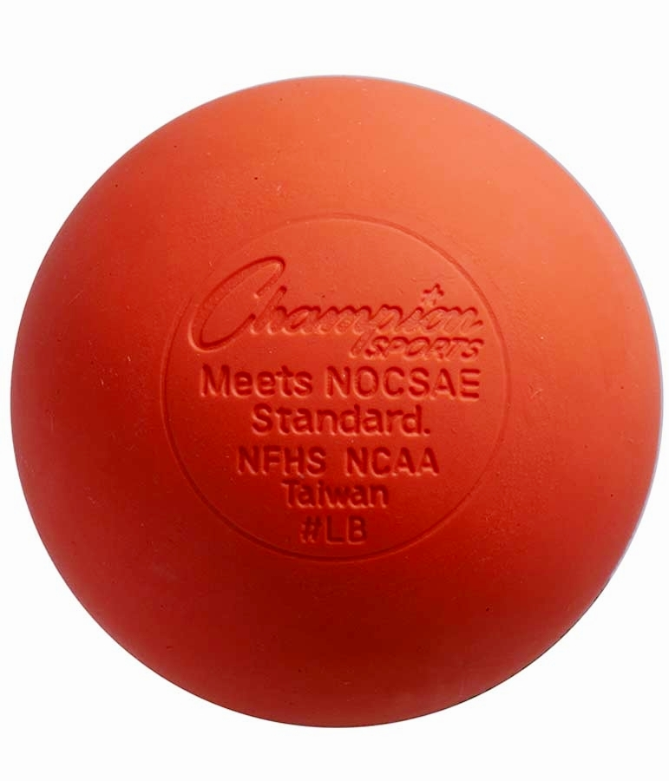
2014 NFHS Boys Lacrosse Major Rules Revisions
Rule 1-5 – Legal for Play
Notes:
Risk Minimization.

Slide 15
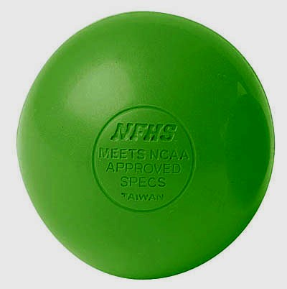
2014 NFHS Boys Lacrosse Major Rules Revisions
Rule 1-5 – Not Legal Play
Notes:
Risk Minimization.

Slide 16
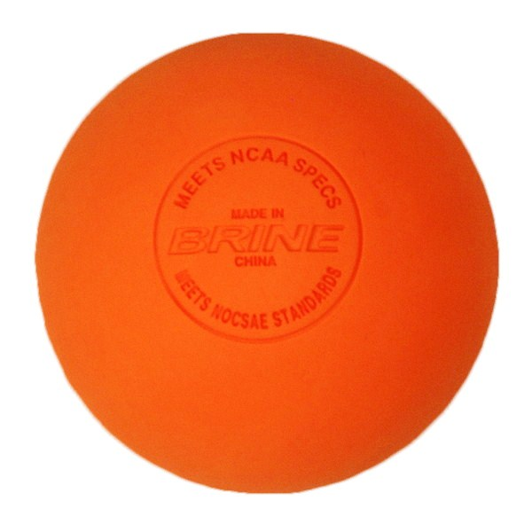
2014 NFHS Boys Lacrosse Major Rules Revisions
Rule 1-5 Note –
Legal for play but without NFHS
Notes:
Risk Minimization.

Slide 17
2014 NFHS Boys Lacrosse Major Rules Revisions
Rule 1-2-7, 8 & 9 The Field
(Increase the size of the Substitution/Table Area)
ART. 7 . . . Two lines shall be drawn on either side of the center line 10 yards from the center line and extending past the scorer’s table.
ART. 8 . . . Each coaches’ area shall extend from the table area 15 yards parallel to the sideline.
ART. 9 . . . Each bench area shall extend from the table area 15 yards parallel to the sideline.
Notes:
A larger Substitution/Table area complements the new substitution rules by allowing more space for players to get on and off the field; and also creates better sight-lines for table personnel.

Slide 18
2014 NFHS Boys Lacrosse Major Rules Revisions
Rule 1-2-7, 8 & 9 The Field
This larger Substitution/Table area complements the new substitution rules by allowing more space for players to get on and off the field; and also creates better sight-lines for table personnel.
Notes:
A larger Substitution/Table area complements the new substitution rules by allowing more space for players to get on and off the field; and also creates better sight-lines for table personnel.

Slide 19
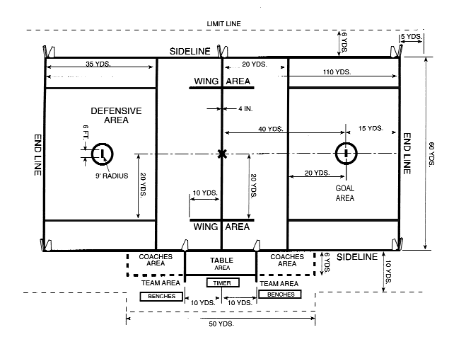
2014 NFHS Boys Lacrosse Major Rules Revisions
Notes:
A larger Substitution/Table area complements the new substitution rules by allowing more space for players to get on and off the field; and also creates better sight-lines for table personnel.

Slide 20
2014 NFHS Boys Lacrosse Major Rules Revisions
Rule 1-7-5 New
ART. 5 . . Any crosse used in a faceoff may not have tape on the plastic throat of the head.
Notes:
Tape on the head (plastic throat area) makes it impossible to tell if a faceoff man has his glove on the plastic throat area of the head. This is a deliberate attempt to deceive and cheat. Almost every faceoff player you see has tape on the throat.

Slide 21
2014 NFHS Boys Lacrosse Major Rules Revisions
Rule 1-7-5 New
Tape on the throat area of the head may make it difficult or impossible to tell if a player has his glove on the throat area of the head, which is a deliberate attempt to deceive.
Notes:
Tape on the head (plastic throat area) makes it impossible to tell if a faceoff man has his glove on the plastic throat area of the head. This is a deliberate attempt to deceive and cheat. Almost every faceoff player you see has tape on the throat.

Slide 22
2014 NFHS Boys Lacrosse New/Revised Situations and Rulings
4.3.4 SITUATION C: On a faceoff, the Team A faceoff player has tape on the plastic part of the stick near the handle. RULING: The player must remove the tape, change sticks, or Team A may send out a new faceoff player. If this process delays the game, it is a technical foul on Team A and the ball is awarded to Team B. There is no stick penalty on Team A.

Slide 23
2014 NFHS Boys Lacrosse Major Rules Revisions
Rule 1-9-1g6
6. Duplicate numbers on jerseys shall not be permitted on the same team. Legal numbers are 0-99.
Note: Beginning in the 2017-18 school year, double-zero, 01, 02, 03 etc. are not legal numbers.
Notes:
There have been some situations where teams were using both 1 and 01, 2 and 02, etc. and considering them as different numbers and other issues. This rule revision is needed to alleviate these problems and make it clear what numbers are allowed.

Slide 24
2014 NFHS Boys Lacrosse Major Rules Revisions
Rule 1-9-1g6
There have been some situations where teams were using both 1 and 01, 2 and 02, etc. and considering them as different numbers. This rule revision is needed to alleviate these problems. The delayed implementation of prohibiting the use of double-zero, 01, 02, 03, etc. will allow schools time to budget for this part of the revision.
Notes:
There have been some situations where teams were using both 1 and 01, 2 and 02, etc. and considering them as different numbers and other issues. This rule revision is needed to alleviate these problems and make it clear what numbers are allowed.

Slide 25
2014 NFHS Boys Lacrosse New/Revised Situations and Rulings
1.9.1 SITUATION G: During the game, A1 is wearing a jersey with the number 2 and A2 is wearing a jersey with the number 02. RULING: Illegal as 2 and 02 are considered to be the same number. Either A1 or A2 must leave the field at the next dead ball and may not return wearing that same number jersey. The official shall warn the coach about jersey numbers and subsequent violations shall be a conduct foul on Team A’s head coach.

Slide 26
2014 NFHS Boys Lacrosse Major Rules Revisions
Rule 1-10-1c, 1-10-2 and 6-6-3a
ART. 1 . . . No player shall participate while wearing illegal equipment. Such equipment shall always include but is not limited to:
c. Electronic communication equipment worn during play by any of the 10 on-field players.
ART. 2 . . . Electronic equipment may be used during play by coaches, non-playing team members, athletic trainers and/or other individuals officially connected with a team, however electronic audio equipment may not be used to communicate with the 10 on-field players.
6-6-3a . . . Use artificial audio enhancement aids (i.e., electronic devices, megaphones) in communicating with players on the field.
Notes:
It is not possible for officials to regulate the use of electronic equipment on the sideline. This revision would allow the use of electronic equipment by coaches and team members on the sideline. Thus, regulation of the use of electronic equipment on the sideline becomes a coach responsibility. Rule 6-6-3a addresses this also but is unchanged to reinforce that it is illegal to use electronic equipment to communicate with any of the 10 on-field players and also to prevent the use of megaphones and other non-electronic equipment to enhance communication with the on-field players.

Slide 27
2014 NFHS Boys Lacrosse Major Rules Revisions
Rule 1-10-1c, 1-10-2 and 6-6-3a
Allows the use of electronic equipment by coaches, non-playing team members, athletic trainers and/or others officially connected with a team to use such equipment while still prohibiting the use of electronic audio equipment to communicate with the 10 on-field players.
Notes:
It is not possible for officials to regulate the use of electronic equipment on the sideline. This revision would allow the use of electronic equipment by coaches and team members on the sideline. Thus, regulation of the use of electronic equipment on the sideline becomes a coach responsibility. Rule 6-6-3a addresses this also but is unchanged to reinforce that it is illegal to use electronic equipment to communicate with any of the 10 on-field players and also to prevent the use of megaphones and other non-electronic equipment to enhance communication with the on-field players.

Slide 28
2014 NFHS Boys Lacrosse New/Revised Situations and Rulings
6.6.3 SITUATION B: The Team A coach is using an electronic display to visually communicate with players on or off the field. RULING: Legal play.

Slide 29
2014 NFHS Boys Lacrosse Major Rules Revisions
Rule 1-10-1h New
h. Eye shade (grease or non-glare strips or stickers) that is not a solid stroke or includes words, numbers, logos or other symbols within the eye shade.
Notes:
This has been a sportsmanship issue and needs to be addressed in the rules.

Slide 30
2014 NFHS Boys Lacrosse New/Revised Situations and Rulings
1.10.1 SITUATION E: A1 has eye shade (grease or non-glare strips or stickers) that is a) a solid stroke; b) includes words, numbers, logos or other symbols; or c) extends outside the eye socket or below the cheek bone. RULING: a) legal; b) illegal; and c) illegal. In b) and c) A1 must adjust the eye shade before returning to play.

Slide 31
2014 NFHS Boys Lacrosse Major Rules Revisions
Rule 2-5
ART. 1 . . . It is recommended that a minimum of three officials be used to control the game (a referee, an umpire, and a field judge). A fourth official, chief bench official (CBO), may be used.
Notes:
While the wording of this rule changes the fundamental philosophy regarding the number of officials used in a game, it does not require that three officials be used – it is only recommended. With this revision, games could still be played using two or even one official if necessary. This change in philosophy is needed to control the game and minimize and properly penalize illegal hits.

Slide 32
2014 NFHS Boys Lacrosse Major Rules Revisions
Rule 2-5
A minimum of three officials is recommended for the game. While the wording of this rule revision changes the fundamental philosophy regarding the number of officials used in a game, it does not require that three officials be used – it is only recommended. With this revision, games could still be played using fewer than three officials if necessary; however, this change in philosophy is indicated to control play, especially with the increased speed of the game.
Notes:
While the wording of this rule changes the fundamental philosophy regarding the number of officials used in a game, it does not require that three officials be used – it is only recommended. With this revision, games could still be played using two or even one official if necessary. This change in philosophy is needed to control the game and minimize and properly penalize illegal hits.

Slide 33
2014 NFHS Boys Lacrosse Major Rules Revisions
Rule 2-5-2e
(e) black stirrup socks with white over-the-calf crew socks on top or knee length one piece white with 4 inch black top or short black socks that cover the ankle;
Notes:
Uniformity with other rule codes.

Slide 34
2014 NFHS Boys Lacrosse Major Rules Revisions
Rule 2-5-2e
The recommended official’s uniform now allows short black socks that cover the ankle. The rules were revised last year to allow black shorts and this change was adopted this year to complement that change.
Notes:
Uniformity with other rule codes.

Slide 35
2014 NFHS Boys Lacrosse Major Editorial Rules Revisions
Rule 2-6-1 Note
NOTE: The game officials maintain administrative responsibilities for the contest through the completion of any required reports or correspondence in response to any action occurring while the officials have jurisdiction. State associations may intercede in the event of unusual incidents that occur before, during or after the officials’ jurisdiction has ended or in the event that a game is interrupted, suspended or terminated prior to the conclusion of regulation play.
Notes:
This editorial revision clarifies that the officials maintain jurisdiction of interrupted and/or suspended contests.

Slide 36
2014 NFHS Boys Lacrosse Major Editorial Rules Revisions
Rule 2-6-1 Note
This is an editorial revision to clarify the officials’ jurisdiction in the event that a game is interrupted or suspended.
Notes:
This editorial revision clarifies that the officials maintain jurisdiction of interrupted and/or suspended contests.

Slide 37
2014 NFHS Boys Lacrosse Major Rules Revisions
Rule 2-6-1 & 2-6-7
ART. 1 . . . The official’s authority begins when they arrive on the field and ends when they leave the immediate playing facility.
ART. 7 . . . At the end of each half, the referee shall check and approve the score. When the officials leave the immediate playing facility at the end of the game, the officials’ jurisdiction has ended and the score has been approved.
Notes:
In the rule book the term “field of play” seems to mean the 110 yard by 60 yard playing surface (one example is Rule 6-6-1 states that coaches may not enter the field of play without permission of the official) . Officials should continue to have some jurisdiction should there be an incident after they step off the “field of play.” Also, the second sentence seemed somewhat redundant. This revision is consistent with the language that gives state associations the ability to address situations that happen before, during and after the game.

Slide 38
2014 NFHS Boys Lacrosse Major Rules Revisions
Rule 2-6-1 & 2-6-7
This clarifies that the official’s authority does not end when they step off of the field of play following a game. If something should occur prior to their leaving the immediate playing facility, they are still authorized to take appropriate action.
Notes:
In the rule book the term “field of play” seems to mean the 110 yard by 60 yard playing surface (one example is Rule 6-6-1 states that coaches may not enter the field of play without permission of the official) . Officials should continue to have some jurisdiction should there be an incident after they step off the “field of play.” Also, the second sentence seemed somewhat redundant. This revision is consistent with the language that gives state associations the ability to address situations that happen before, during and after the game.

Slide 39
2014 NFHS Boys Lacrosse New/Revised Situations and Rulings
2.6.1 SITUATION: Officials are present on the edge of the field during the post-game handshake. A1 and B1 begin an altercation, with each exchanging blows. May A1 and B1 be ejected? RULING: Yes. The officials' authority is still in effect as they have not left the immediate playing facility.

Slide 40
2014 NFHS Boys Lacrosse Major Rules Revisions
Rule 2-10-1
Article 1. At the start of each period a minimum of four balls should be spaced equidistant from each other five yards beyond the end line and four on both sidelines. On the bench side, balls should be placed at the scorer’s table.
Notes:
Putting balls on the sideline will speed up restarts and shorten overall game times.

Slide 41
2014 NFHS Boys Lacrosse Major Rules Revisions
Rule 2-10-1
In addition to the four balls placed on each end line, the home team must now also place four balls on each sideline. Putting balls on the sidelines will speed up restarts and shorten overall game times.
Notes:
Putting balls on the sideline will speed up restarts and shorten overall game times.

Slide 42
2014 NFHS Boys Lacrosse Major Rules Revisions
Rule 4-4-3
ART. 3 . . . During the faceoff in all penalty situations, there must be four players in the defensive area and three players in the offensive area. Exception: When a team has three players in the penalty area, a player may come out of its defensive area to take the faceoff but must remain onside.
Notes:
This will provide a greater opportunity for the offended team to retain its man-advantage.

Slide 43
2014 NFHS Boys Lacrosse Major Rules Revisions
Rule 4-4-3
There must be four players in the defensive area and three players in the offensive area during faceoffs in penalty situations except when a team has three players in the penalty area. This will provide a greater opportunity for the offended team to retain its man-advantage.
Notes:
This will provide a greater opportunity for the offended team to retain its man-advantage.

Slide 44
2014 NFHS Boys Lacrosse Major Rules Revisions
Rule 4-10
A team is considered offside when it has:
a. more than six players in its offensive half of the field (between the centerline and the end line) including players in the penalty box, or
b. more than seven players in its defensive half of the field (between the centerline and the end line) including players in the penalty box.
Notes:
The unfair advantage in an offside situation is created by too many players on one side of the field- not too few. This change lets the foul reflect the unfair advantage; and minimizes risk by allowing officials to "count forward," keeping their attention on the active side of the field.

Slide 45
2014 NFHS Boys Lacrosse Major Rules Revisions
Rule 4-10
This revises the requirement to more accurately reflect the unfair advantage created by an offside situation and allows the official to “count forward,” keeping their attention focused on the active side of the field.
Notes:
The unfair advantage in an offside situation is created by too many players on one side of the field- not too few. This change lets the foul reflect the unfair advantage; and minimizes risk by allowing officials to "count forward," keeping their attention on the active side of the field.

Slide 46
2014 NFHS Boys Lacrosse Major Rules Revisions
Rule 4-11
ART. 1 . . . If only one team is offside, a technical foul shall be called against the offending team.
ART. 2 . . . If both teams are offside and one of the teams has possession of the ball, the players shall be placed onside and play resumed with the team in possession of the ball retaining possession.
ART. 3 . . . If both teams are offside and neither team has possession of the ball, the players shall be placed onside, and the ball shall be awarded according to alternate-possession rule.
Notes:
This revision is needed to address some confusion with enforcement of the offside rule.

Slide 47
2014 NFHS Boys Lacrosse Major Rules Revisions
Rule 4-11
Articles 4 and 5 were removed from the offside enforcement rule. This revision will eliminate some confusing language and clarify procedure for offside enforcement.
Notes:
This revision is needed to address some confusion with enforcement of the offside rule.

Slide 48
2014 NFHS Boys Lacrosse Major Rules Revisions
Rule 4-21
Substitution Procedures
ART.1 . . . Substitution may take place without the necessity of waiting for suspension of play by an official. Players may enter the field of play from the substitution area under the following conditions:
a. The player must be properly equipped. b. The player may not enter the substitution area until his substitution is imminent. c. The player leaving the field of play must exit via the substitution area. d. The substitute must wait until such player is off the field of play, and the substitute may not delay his entry onto the field. e. The substitute must always yield his position in the substitution area to any player exiting the field. f. Substitution may take place while play is suspended. Note: Any delay of the game is to be enforced strictly. See Rule 6-5-f for method of enforcement.
ART. 2 . . . Substitution may take place while play is suspended as follows:
a. End of a period.
b. Scoring of a goal.
c. Injury timeout.
d. Equipment adjustment.
e. After a time-serving penalty.
f. Team timeouts.
Note: Any delay of the game is to be enforced strictly. See Rule 6-5-f for method of enforcement.
Notes:
Uniformity with other rules codes.

Slide 49
2014 NFHS Boys Lacrosse Major Rules Revisions
Rule 4-21
The previous substitution language in Rules 4-22, 4-23 and 4-24 was deleted and replaced with a new Rule 4-21 called “Substitution Rules.” This new language eliminates the use of the horn for substitution when play is suspended which will simplify substitution procedures for coaches, players and officials and will speed up the game.
Notes:
Uniformity with other rules codes.

Slide 50
2014 NFHS Boys Lacrosse Major Rules Revisions
Rule 5-3-5 New
ART. 5 . . A body check that targets a player in a defenseless position. This includes but is not limited to: (i) body checking a player from his “blind side”; (ii) body checking a player who has his head down in an attempt to play a loose ball; and (iii) body checking a player whose head is turned away to receive a pass, even if that player turns toward the contact immediately before the body check.
PENALTY: Two- or three-minute non-releasable foul, at the official’s discretion. An excessively violent violation of this rule may result in an ejection.
Notes:
Intentional player-to-player collisions with players in a defenseless position – i.e. while focused on scooping a ground ball, clearing the crease on a loose ball situation in front of the goal, etc. – are a concern and this revision will reinforce the need to eliminate these collisions from the game. NOTE: Sports medicine research indicates that the severity of certain injuries may be reduced if a player can anticipate and prepare himself for an oncoming hit.

Slide 51
2014 NFHS Boys Lacrosse Major Rules Revisions
Rule 5-3-5 New
This new rule stipulates that a body check that targets a player in a defenseless position is illegal and specifies a minimum two- or three-minute non-releasable penalty for this violation. Intentional player-to-player collisions with players in a defenseless position, e.g., while focused on scooping a ground ball, clearing the crease on a loose ball situation in front of the goal, etc., are a concern and this revision will reinforce the need to eliminate these collisions from the game.
Notes:
Intentional player-to-player collisions with players in a defenseless position – i.e. while focused on scooping a ground ball, clearing the crease on a loose ball situation in front of the goal, etc. – are a concern and this revision will reinforce the need to eliminate these collisions from the game. NOTE: Sports medicine research indicates that the severity of certain injuries may be reduced if a player can anticipate and prepare himself for an oncoming hit.

Slide 52
2014 NFHS Boys Lacrosse Major Rules Revisions
Rule 5-4 Penalty
PENALTY: Two- or three-minute non-releasable foul, at the official’s discretion. An excessively violent violation of this rule may result in an ejection.
Notes:
Hits to the head/neck continue to be a concern and this increased penalty will reinforce the need to eliminate these types of hits from the game.

Slide 53
2014 NFHS Boys Lacrosse Major Rules Revisions
Rule 5-4 Penalty
With this revision, the penalty for hits to the head/neck will now be a minimum of a two- to three-minute non-releasable. Hits to the head/neck continue to be a concern and this increased penalty will reinforce the need to eliminate these types of hits from the game.
Notes:
Hits to the head/neck continue to be a concern and this increased penalty will reinforce the need to eliminate these types of hits from the game.

Slide 54
2014 NFHS Boys Lacrosse Major Rules Revisions
Rule 7-2f New
f. A maximum of three players from the same team can be in the penalty area serving penalties at the same time. The penalty time of any additional player(s) shall not start until the penalty time of one of the three players in the penalty area expires. The additional penalized player(s) shall wait in the bench area immediately next to the scorer’s table but not in the table area. A team shall not be required to play with fewer than seven on-field players solely because of players serving penalties. A player’s penalty cannot be released by a goal until he is in the penalty area and the time on his penalty has started to elapse.
Notes:
Minimize risk for participants and clarifies procedure for administration of penalties and substitution.

Slide 55
2014 NFHS Boys Lacrosse Major Rules Revisions
Rule 7-2f New
This revised rule specifies that no more than three players on a team can be in the penalty area at any time. If more than three players on a team are assessed penalty time to be served concurrently, the additional penalized team member(s) must wait in the bench area until the penalty time of one of the three players in the penalty area expires. This will eliminate the possibility of a team playing with fewer than seven players because of penalties which will minimize risk for participants. In addition, this change will clarify procedure for administration of penalties and substitution.
Notes:
Minimize risk for participants and clarifies procedure for administration of penalties and substitution.

Slide 56
2014 NFHS Boys Lacrosse New/Revised Situations and Rulings
7.2 SITUATION A: A1, A2, A3 and A4 receive one-minute releasable penalties that are all reported during the same dead ball. A1, A2 and A3 begin to serve their penalties at the same time, while A4 waits in the bench area immediately next to the scorer’s table but not in the table area. Team A restarts play with seven players on the field. (1) Team B scores a goal after 30 seconds. (2) Team B does not score a goal in the next minute. RULING: (1) A1, A2 and A3 are released and A4 begins serving his one-minute penalty in the table area. COMMENT: The team penalty against team A was four releasable penalties causing the team to play short for one minute or until a goal is scored. Since a goal was scored, the team returns to full strength, however A4 still must serve his one-minute penalty. (2) A1 and A2 may enter the field. A3 must exit to the bench area and A4 steps into the table area and begins serving his penalty. Team A is now playing with nine players on the field. A3 may now substitute into the game in the normal manner, if desired.

Slide 57
2014 NFHS Boys Lacrosse New/Revised Situations and Rulings
7.2 SITUATION B: Team A started the game with 11 players (the 10 on-field players and one player on the bench). During the course of play, A1 and A2 are injured and unable to return to play leaving team A with only nine on-field players. Later in the game, A3, A4 and A5 receive one-minute releasable penalties. All three players report to the table area to serve their penalties leaving the team with only six on-field players. RULING: Legal. COMMENT: A team can continue to play with fewer than seven players in this instance since this situation was not caused “solely because of penalties.” (2-1-3)

Slide 58
2014 NFHS Boys Lacrosse Major Rules Revisions
Rule 7-8-2k New
The official shall withhold the whistle until:
k. A defensive foul is committed during the final two minutes of regulation play with the team that is ahead and possessing the ball in the goal/attack area, unless a scoring play is imminent.
Notes:
This revision will simplify procedure for the final two minutes of the game and discourage the defensive team from fouling to gain possession.

Slide 59
2014 NFHS Boys Lacrosse Major Rules Revisions
Rule 7-8-2k New
This revision specifies that, during a Flag Down situation (Slow Whistle), the officials will stop play to enforce penalties if a subsequent second defensive foul occurs “during the final two minutes of regulation play with the team that is ahead possessing the ball in the goal/attack area, unless a scoring play is imminent.” This change will simplify procedure for the final two minutes of the game and discourage the defensive team from committing further fouls.
Notes:
This revision will simplify procedure for the final two minutes of the game and discourage the defensive team from committing further fouls.

Slide 60
2013 NFHS Boys Lacrosse Points of Emphasis

Slide 61
2014 NFHS Boys Lacrosse Points of Emphasis
2014 Points of Emphasis
Age Specific Rules
Properly Worn Equipment
Slashing
Balls

Slide 62
2014 NFHS Boys Lacrosse Points of Emphasis
Age Specific Rules
The rules in this book are designed for high school aged players. For games played by younger age groups, age specific rules should be utilized. US Lacrosse has established such age specific rules for youth play which are contained on page 94 of the 2014 NFHS Boys Lacrosse Rules Book.

Slide 63
2014 NFHS Boys Lacrosse New/Revised Situations and Rulings
3.1.1 SITUATION A: In a Junior Varsity or Youth game, may both coaches agree to play: a) 10-minute quarters. b) 12-minute running-time quarters. RULING: Legal in both cases.

Slide 64
2014 NFHS Boys Lacrosse Points of Emphasis
Properly Worn Equipment
The rules require players to wear a number of items of protective equipment including a helmet with a face mask, a mouth guard, protective gloves, shoulder pads, shoes and arm pads. Further, the rules state that these items must be professionally manufactured and not altered. Coaches, officials and players are reminded that these items must be properly fitted and properly worn to maximize protection. Items of protective equipment that are improperly fitted increase the risk of injury for players. Likewise, items that have been altered from the original manufacturer’s specifications reduce the protective characteristics of the product.

Slide 65
2014 NFHS Boys Lacrosse Points of Emphasis
Properly Worn Equipment (continued)
Ensuring that players are not playing with illegal equipment and are properly wearing all required equipment or is a major responsibility of all lacrosse coaches. Coaches are reminded of their obligation to carefully inspect their players’ equipment and instruct them on how to properly wear this equipment.

Slide 66
2014 NFHS Boys Lacrosse Points of Emphasis
Slashing
There is no place in the game for slashing. All participants are reminded that all slashes are illegal and coaches must properly instruct their players to avoid making such slashes. Officials should be especially alert to call these penalties whenever they occur. If a player commits multiple slashes, multiple fouls should be called.

Slide 67
2014 NFHS Boys Lacrosse Points of Emphasis
Balls
All balls are to meet the NOCSAE standards and all game balls must include labeling, which states “Meets NOCSAE Standard. NFHS.” These standards establish performance requirements in the size, weight and compressibility and other characteristics of the ball. These standards were established to minimize risk for the players. Coaches are reminded it is their obligation to supply and only utilize such balls.

Slide 68
Additional NFHS Information
2014 NFHS Boys Lacrosse Rules Interpretation Webinar Meeting
January 28, 2014 – 2:00 pm. (Eastern Standard Time)
NFHS Boys Lacrosse Rule Change Proposal Form Due
June 25, 2014
2014 NFHS Boys Lacrosse Rules Committee Meeting
July 21-23, 2014 – Indianapolis, IN
E-mail addresses:
Kent Summers – ksummers@nfhs.org
Angie Hays – ahays@nfhs.org

Slide 69
The following sports are available in an NFHS PowerPoint Presentation:
Baseball
Basketball
Football
Girls Gymnastics
Volleyball
Track and Field
Soccer
Softball
Swimming & Diving
Wrestling
Boys Lacrosse
To order copies please contact: Carol Ratliff at the NFHS
Phone: 317-822-5731 or Fax your Request to 317.822.5700

Slide 70
Questions?
Contact state association for interpretations. If state athletic/activities association does not administer lacrosse, contact Kent Summers, NFHS Boys Lacrosse Rules Editor 317-972-6900 ksummers@nfhs.org

